Slide 1
Practical Strategy:
Breaking New Ground Without Reinventing the Wheel
Susan Westwater,
Co-author of Voice Strategy and Voice Marketing

Slide 2
The Good News
Conversational AI and Voice technology have hit mass adoption
64% of marketers say AI is very important or critically important over the next 12 months ¹
1) 2023 State of Marketing AI Report, Marketing AI Institute

Slide 3
But…
Most marketers remain in the early stages of understanding and adopting AI
Companies are laggings behind in providing AI education and guidance
Teams are forever being asked to do “more with less”
Source: 2023 State of Marketing AI Report, Marketing AI Institute

Slide 4
So, how are we going to do this?

Slide 5
You’re not starting from scratch

Slide 6
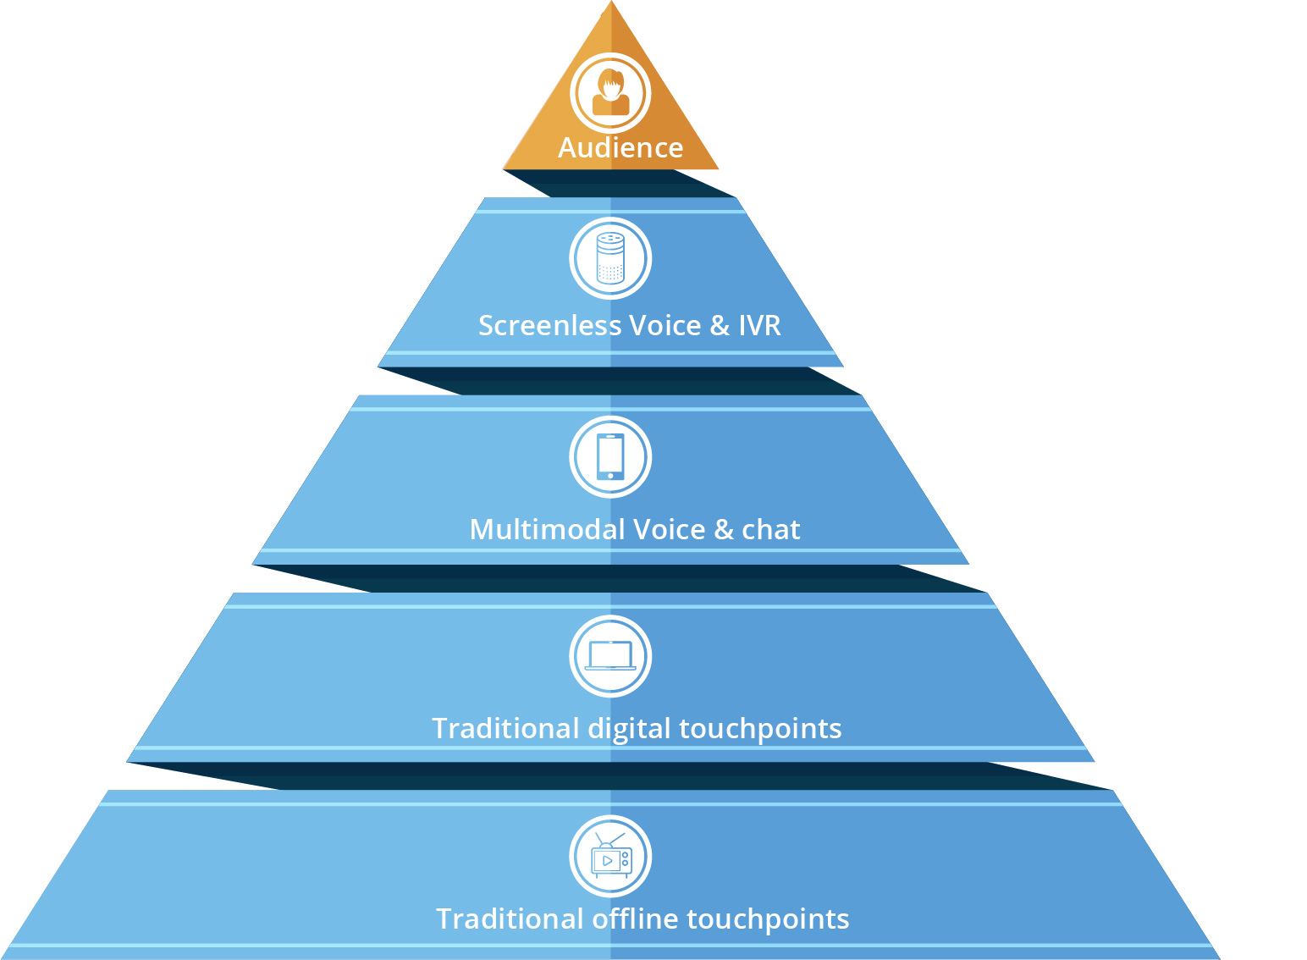
The information needs of your audience is the same regardless of touchpoint

Slide 7
So, we have a place to start
Existing information and tools can help us forge ahead

Slide 8
Know your target
What do you know about your customers?
Personas & segmentations
Behaviors & content maps

Slide 9
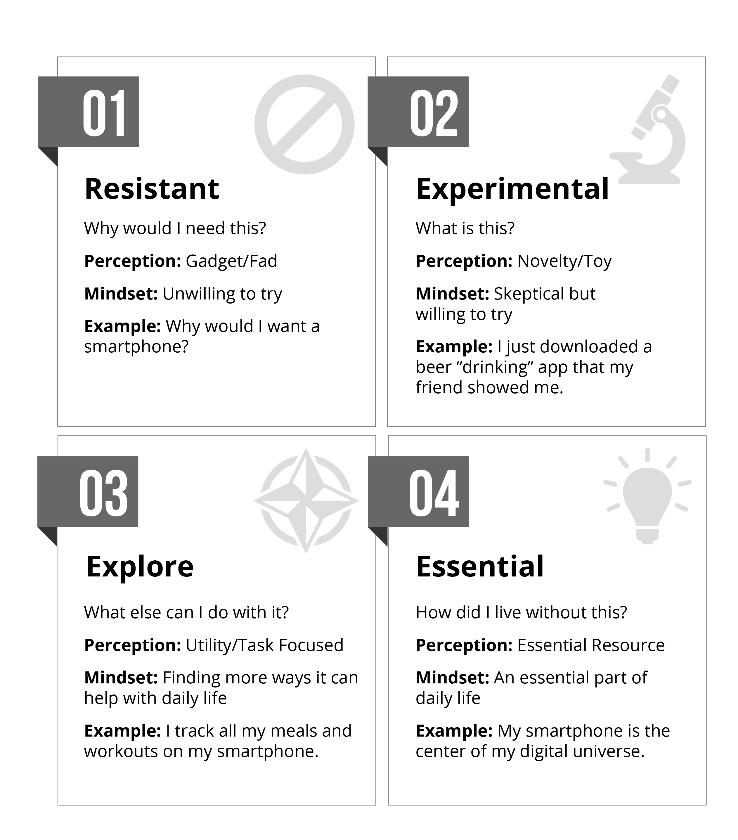
Understand their current mindset about AI and Voice

Slide 10
Map the customer journey
Map activities and touchpoints
Find where there’s friction

Slide 11
Know the top asks and tasks
Content mapping and top tasks identify what people want to know and do
They also show where there are gaps in support

Slide 12
Inventory and audit your content
Shortcuts the search for relevant, existing content
Gives language cues and what works (and what doesn’t)

Slide 13
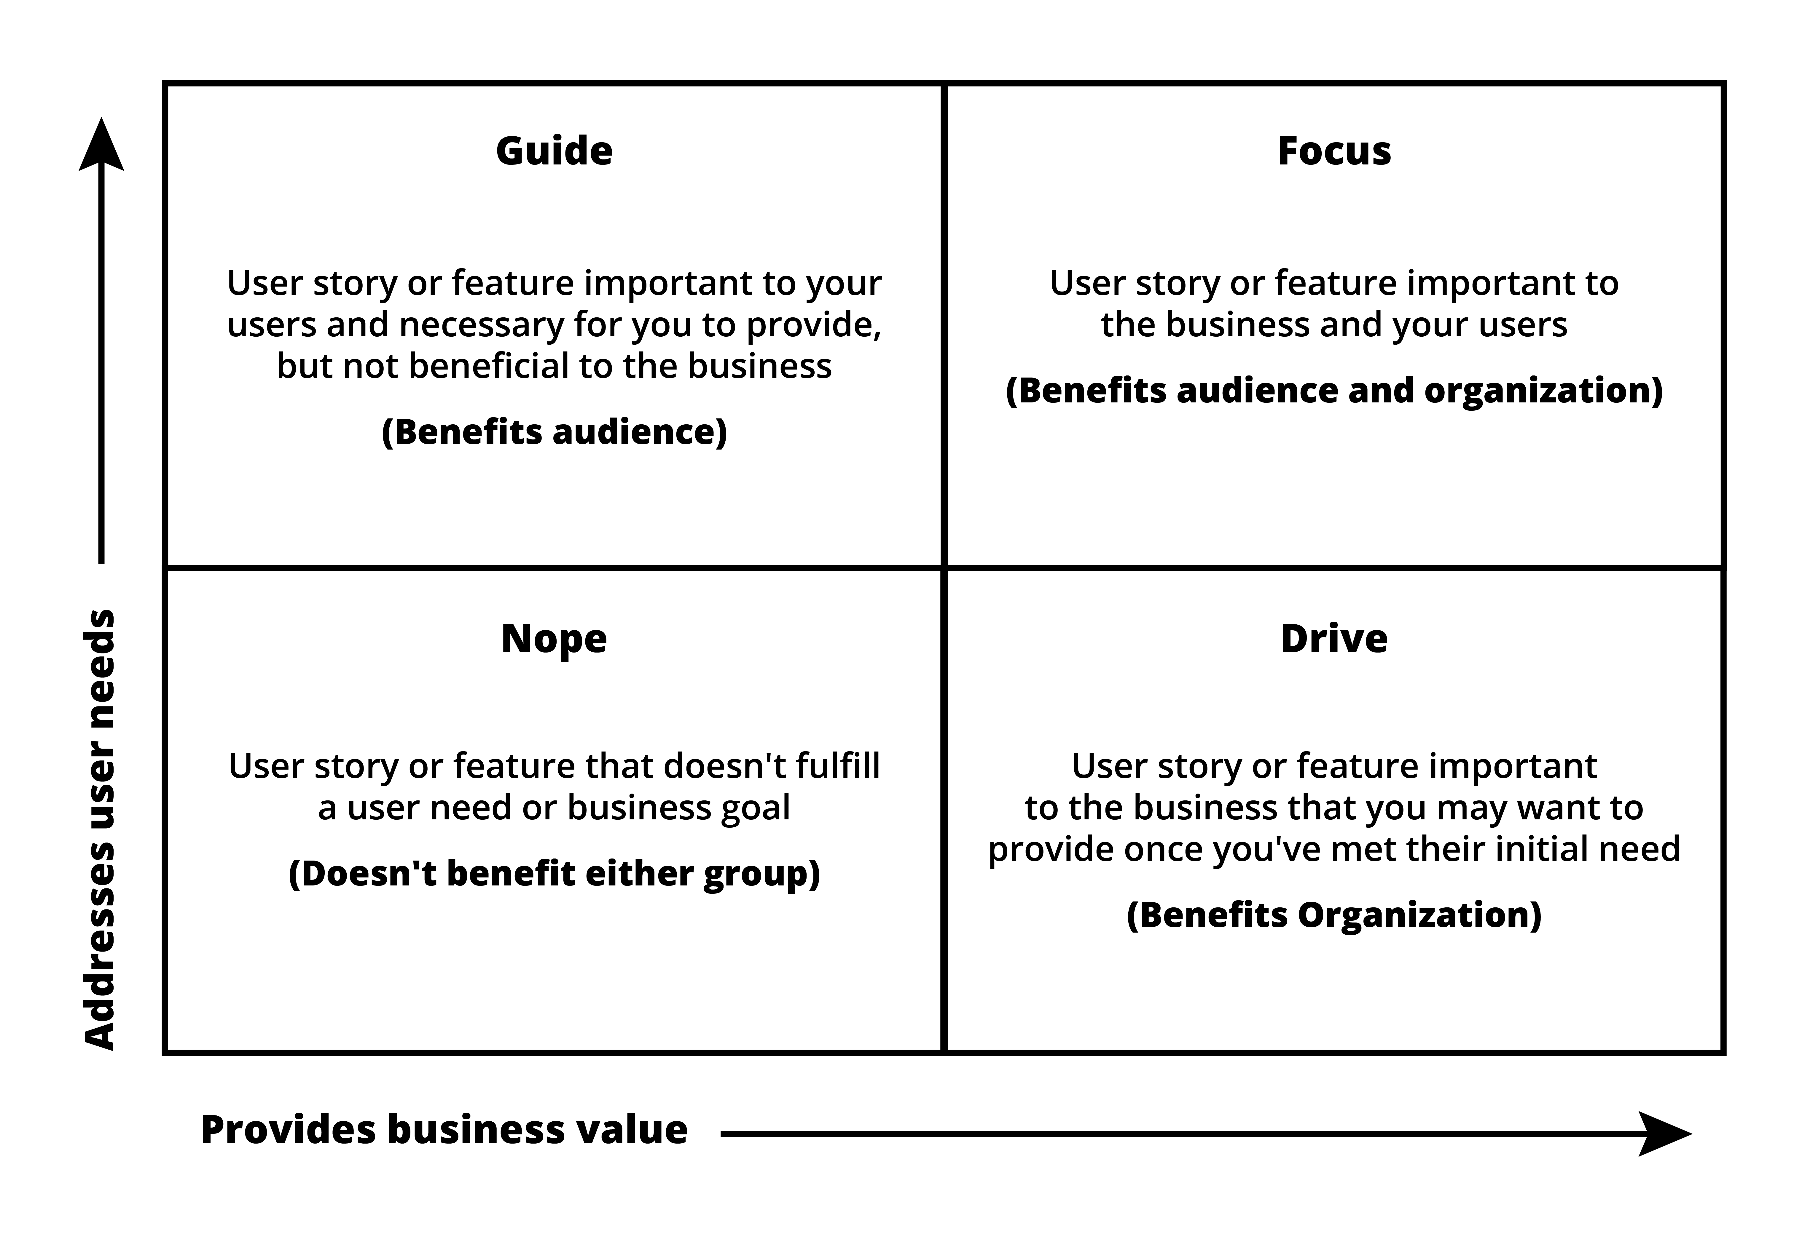
Prioritize
Road maps and priorities are essential to success
Inspired by The Content Strategy Toolkit, Meghan Casey, 2018

Slide 14
Build on the brand guidelines
Governance and style guides ensure consistency everywhere
Build upon the existing personality, tone of voice, and standards

Slide 15
Don’t forget how it sounds
What does your brand sound like?
Have an intentional sonic identity
Use voice and audio to support and connect

Slide 16
Have a plan to create and launch the best experience for your brand and audience

Slide 17
When done right, Conversational AI
Enhances brand engagements across platforms and channels
Provides critical intelligence on the customer’s purpose
Humanizes the journey across digital and physical touch points

Slide 18
Considerations for success
Know your audience’s needs
Keep it simple but relevant
Don’t ignore the UX
Be consistent
Drive traffic and awareness

Slide 19
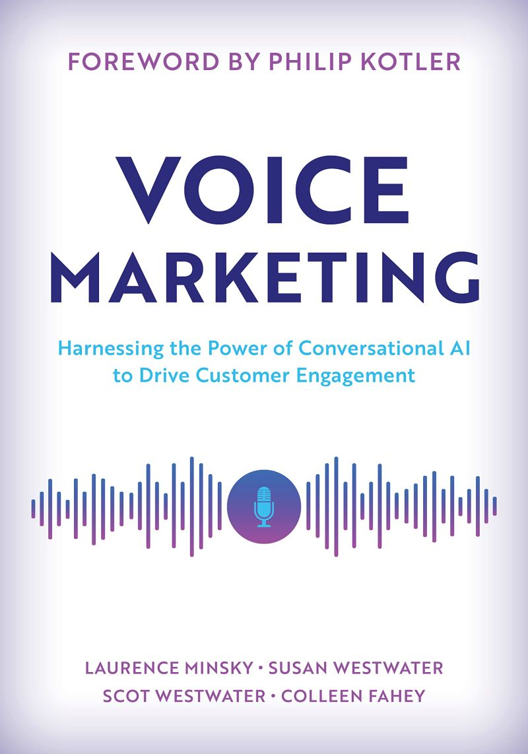
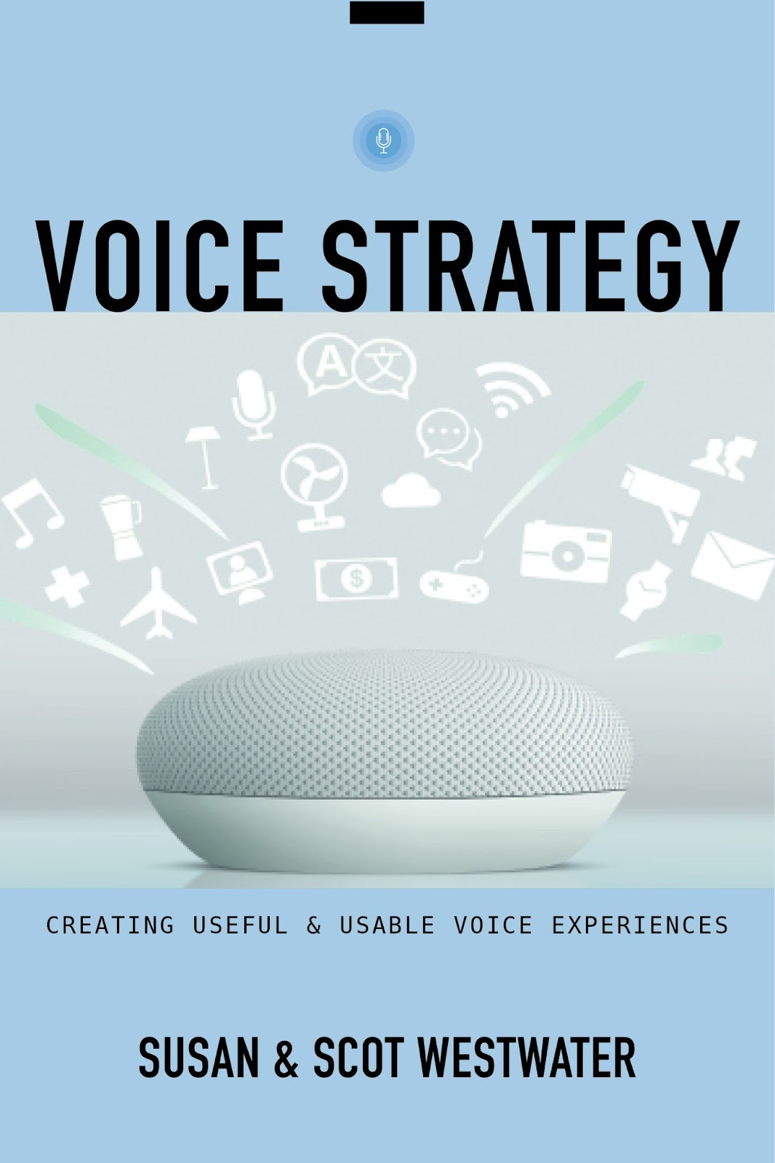
Further reading

