Slide 1

Using Copilot to Improve Job Satisfaction
Voice & AI
Scott Morgan
Notes:
1:00
Running: 1:00
Thank you for joining me today to learn how using GitHub Copilot can improve your job satisfaction.
I am a Doctoral Student at Marymount University working toward my Doctorate in Business Administration. In preparing for my dissertation, I am studying AI code-generating tools and their effects on developer performance, including job satisfaction.
I have also worked in IT since 1995. I’ve done several things in IT over the years, but I’ve always been a developer at heart. It’s the one thing I enjoy doing and the one thing I rarely get to do now. So, when I can write code, my job satisfaction increases.

Slide 2

Copilot Chat Preview
Notes:
2:30
Running: 3:30
FizzBuzz
Reverse a string
Palindrome check
Quicksort
Reverse a linked list
Abstract factory

Slide 3
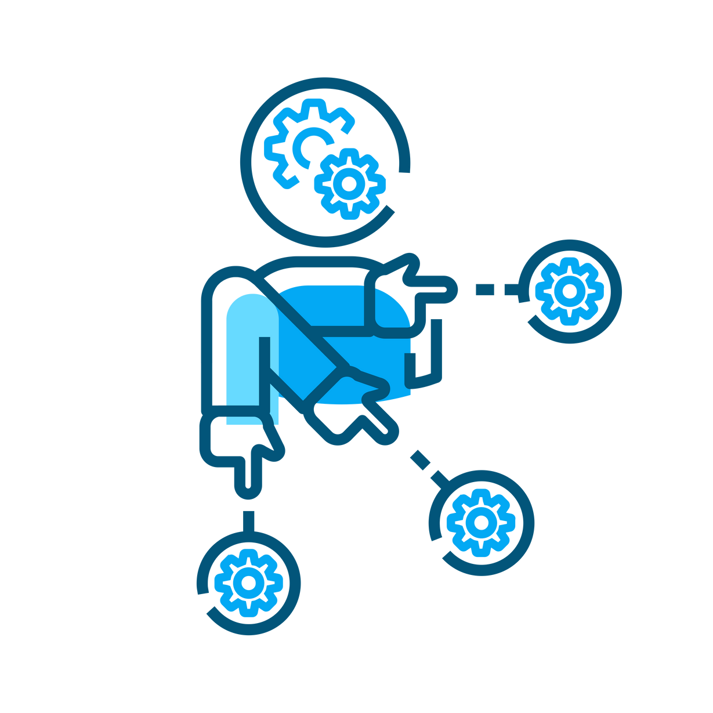
Objectives
What is Copilot
How Copilot Works
The Building Blocks of AI Code Generation
Using Copilot as a Pair Programmer
Copilot Drawbacks
Copilot's Affect Developer Job Satisfaction
How Copilot Can Improve Your Job Satisfaction
Notes:
1:00
Running 4:30
At the end of this session, you should be able to understand...
What is Copilot
How Copilot works
The History of AI Code-Generation
Using Copilot as a pair programmer
How Copilot can affect developer job satisfaction

Slide 4

What is GitHub Copilot
AI-Powered Code Completion Tool
Developed by OpenAI in Collaboration with GitHub
Use OpenAI's Codex
Assists Developers with Context-Aware Code Suggestions
Leverages Machine Learning Models Trained on Publicly Available Code
Notes:
1:00
Running: 5:30
GitHub Copilot is an AI-powered code completion tool developed by OpenAI in collaboration with GitHub. It is designed to assist developers by providing context-aware code suggestions and auto-completion within their preferred code editors.
Copilot leverages machine learning models trained on publicly available code to generate code snippets and completions.
Microsoft owns GitHub and part of OpenAI , so they brought those two technologies together, like shredded lettuce and ziplock bags, to create a new product.
Reference
Taking Flight with Copilot: Early Insights and Opportunities of AI-powered pair-programming Tools
(Bird et al., 2022)

Slide 5
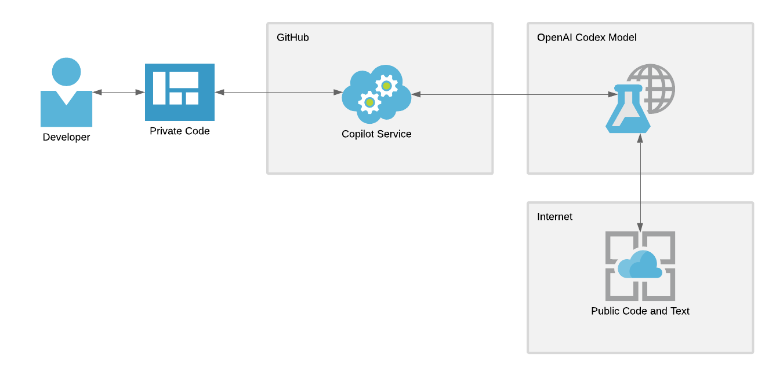
How Copilot Works
Notes:
1 Minute:
Running: 6:30
As the programmer writes code, requests are continuously sent to Copilot’s AI model, which analyzes the code, identifies valuable suggestions, and sends those back to the programmer, like IntelliSense in modern IDEs.
Copilot can suggest complete lines of code or functions by analyzing how you code. Copilot can assemble code from user comments and predicts your code by just reading the function name you have declared.
It allows you to cycle through alternative suggestions and edit the suggested code manually. It auto-fills repetitive code or creates unit tests for your methods.
The Copilot editor extension sends your comments and code to the Copilot service, using OpenAI Codex to synthesize and suggest code.

Slide 6

Copilot Building Blocks of Job Satisfaction
History of Code Generation
History of Artificial Intelligence
SPACE Framework
Job Satisfaction Theories
Notes:
1:00
Running: 7:30
Copilot combines the concept of code generation and the technology of artificial intelligence, both of which have been around since the 1950s.
In addition, job satisfaction is part of developer performance, and the SPACE Framework measures developer productivity.
I wouldn't be a student if I didn't discuss some theories in my presentation, so I will briefly touch on Job Satisfactions theories.

Slide 7
A Brief History of Code Generation
1951
1957
1959
1991
1997
Grace Hopper creates the A-0 compiler
  (Hopper, 1952)
IBM releases Fortran
(Backus et al., 1957)
COBOL is created by a team of computer scientists
(Sammet, 2000)
Integrated Development Environments (IDE)
(Hou & Wang, 2009)
Intellisense is released as part of Visual Basic 5.0
Notes:
3:00
Running : 10:30
Automatic source code generation for computer programs is not new and can be traced back to 1951, when Grace Hopper created the first compiler. Initially, computers were programmed using machine code, a series of bits represented by 0s and 1s corresponding to instructions for the computer’s processor.
However, the A-0 compiler allowed users to express math problems in a more human-readable format and then translate those high-level instructions into machine code. (Hopper, 1952).
Developed by IBM in the 1950s and released in 1957, Fortran (Formula Translation) is widely considered the first high-level programming language. It was popular in the scientific and engineering community due to its ability to express complex mathematical formulas and algorithms in a human-readable and concise way. However, once again, the machine language was hidden from the programmer by a compiler that generated the machine code from this more human-readable language (Backus et al., 1957).
COBOL (Common Business-Oriented Language) is another popular early programming language released in 1959 and created by a team of computer scientists and industry representatives to create a portable, English-like programming language suitable for business applications. COBOL was designed to be easily readable and self-documenting and focused on data processing features like file handling, record manipulation, and report generation. COBOL was popular in insurance, finance, and government and is still used today for legacy applications. Just like Fortran, COBOL generated machine code using a compiler, and all that machine code was hidden from the programmer (Sammet, 2000).
Another form of programming language code generation is the integrated development environment (IDE). While an IDE does not generate complete source code for a program, it generates code snippets as templates. For example, an IDE used to build Windows applications will create much of the source code for handling the creation, manipulation, and destruction of the forms and the controls on those forms.
Visual Basic 1.0, considered the first IDE, helped programmers hide the underlying code and create forms and their components, such as text boxes, buttons, and labels. The programmer did not need to know how those components worked because Visual Basic handled the low-level code generation. In the same way that compilers assisted the first programmers, Visual Basic made Windows programming more accessible (Hou & Wang, 2009).
Another feature of modern IDEs is a form of code completion called IntelliSense. IntelliSense provides programmers with real-time context-aware suggestions, auto-completion, and other helpful information. For example, as a programmer enters commands,
IntelliSense will suggest class names, function names, variable names, or other programming constructs. Then, the programmer can use the keyboard to scroll through the suggestions and select the appropriate construct, speeding up development time and reducing errors (Míšek, 2017).
From the earliest compilers, through the creation of programming languages, and up to the most modern IDEs, automatic code generation has been refined and used almost as long as computers have existed.
For programmers, these code-generation tools are valuable because they reduce errors, encapsulate complex concepts, accelerate development, and allow the exploration of ideas.

Slide 8
A Brief History of Artificial Intelligence
Dartmouth Conference | Genesis of AI | (McCarthy et al., 1955)
Machine Learning (M/L) | Subfield of AI Focusing on Enable Computers to Learn and Improve Performance on a Task Without Being Explicitly Programmed. | (Mitchell, 2007)
Natural Language Processing (NLP) | Subset of AI and Linguistics Focusing on Interactions Between Computers and Human Languages | (Liddy, 2001)
Large Language Models (LLM) | Type of Machine Learning Based on Advanced Neural Network Architectures. Examples include OpenAI's GPT and Google's BERT | (Chen et al., 2021) (Wolf et al., 2020)
Notes:
1:30
Running: 12:00
Like automatic code generation, artificial intelligence has existed since the 1950s. In 1955, a proposal for the Dartmouth Conference aimed to simulate machine learning by describing every learning aspect. The Dartmouth conference is regarded as the beginning of artificial intelligence (AI) as a field of study, and it's where John McCarthy coined the phrase "Artificial Intelligence" (McCarthy et al., 1955).
Machine Learning (ML) is a subfield of AI that focuses on developing algorithms and statistical models that enable computers to learn and improve performance on a task without being explicitly programmed. ML is based on the idea that computers can automatically learn from data, identify patterns, and make decisions or predictions without human intervention (Mitchell, 2007).
Natural language processing (NLP) is a subset of AI and linguistics focusing on interactions between computers and human languages. NLP aims to enable computers to understand, interpret, generate, and respond to human language meaningfully and usefully. Furthermore, NLP is a critical component of AI code generation tools since the user must ask a question or provide some prompt for the AI to generate source code (Liddy, 2001).
Large language models (LLM) are machine learning based on advanced neural network architectures, such as transformers (Chen et al., 2021). These models are trained on massive amounts of text data, enabling them to understand language broadly.
In the case of AI code generation, the models are trained on program source code (Wolf et al., 2020).

Slide 9



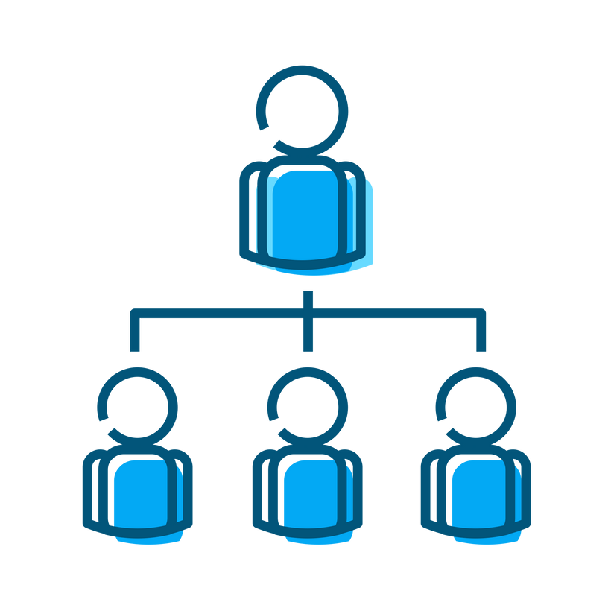

Satisfaction and Well Being
SPACE Framework
  How fulfilled You Are
Performance
  Quality of Code and Value Created
Activity
A systematic approach to measuring, understanding, and optimizing engineering productivity.
  Code Commits and Pull Requests
Collaboration
  How Well You Work With Others
Efficiency/Flow
  Complete Work With Minimal Interruptions
Forsgren, N., Storey, M. A., Maddila, C., Zimmermann, T., Houck, B., & Butler, J. (2021). The SPACE of developer productivity: There's more to it than you think. Queue, 19(1), 20-48. https://doi.org/10.1145/3454122.3454124
Notes:
1:30
Running: 13:30
Developer productivity is more than just lines of code and is more complicated than a single metric. The SPACE framework was designed to understand developer productivity fully.
Satisfaction and well-being are the first part of the framework and describe how fulfilled developers are with their job, culture, tools, and team. This is the central part of the SPACE Framework we will focus on today.
Performance is the second part of the SPACE framework and is best defined as the quality of the code created by the developer, along with customer satisfaction.
The “A” in the SPACE framework represents the developer's activity. Some examples of activities include code commits and pull requests.
Part of a developer's job is assisting teammates, and for this reason, collaboration is the next metric in the SPACE framework and is designed to capture how people work together.
Lastly, efficiency/flow is the final part of the framework and is defined as the ability to complete work with minimal interruptions.
The SPACE framework can be used as a common way to describe developer productivity.
(Forsgren, et al., 2021)

Slide 10



Job Satisfacation Theories
Two-Factor Theory
Expectancy Theory
Job Characteristics Model
  Provides developers with assistance, automates repetitive tasks, and helps them accomplish coding tasks more efficiently
  Developers may expect using the tool to improve their coding productivity and result in better code outcomes
  Offering assistance and reducing mundane tasks allows developers to engage in more creative and challenging aspects of their work
Herzberg. F. I., & Hamlin, R. M. (1961). A motivation-hygiene concept of mental health. Mental Hygiene, 45, 394-401.
Vroom, V., Porter, L., & Lawler, E. (2005). Expectancy Theories
Ali, S. A. M., Said, N. A., Abd Kader, S. F., Ab Latif, D. S., & Munap, R. (2014). Hackman and Oldham's job characteristics model to job satisfaction. Procedia-Social and Behavioral Sciences, 129, 46-52.
Notes:
1:00
Running: 14:30
Herzberg's Two-Factor Theory:
Copilot could be seen as a tool contributing to the motivator aspect of Herzberg's theory. It provides developers with assistance, automates repetitive tasks, and helps them accomplish coding tasks more efficiently, which can lead to increased job satisfaction and motivation.
Expectancy Theory:
The use of Copilot may influence job satisfaction based on the expectancy component of the theory. Developers may expect using the tool to improve their coding productivity and result in better code outcomes, positively impacting their job satisfaction.
Job Characteristics Model:
Copilot may enhance certain job characteristics like skill variety and task identity by aiding software developers in various aspects of their work. Offering assistance and reducing mundane tasks allows developers to engage in more creative and challenging aspects of their work.

Slide 11
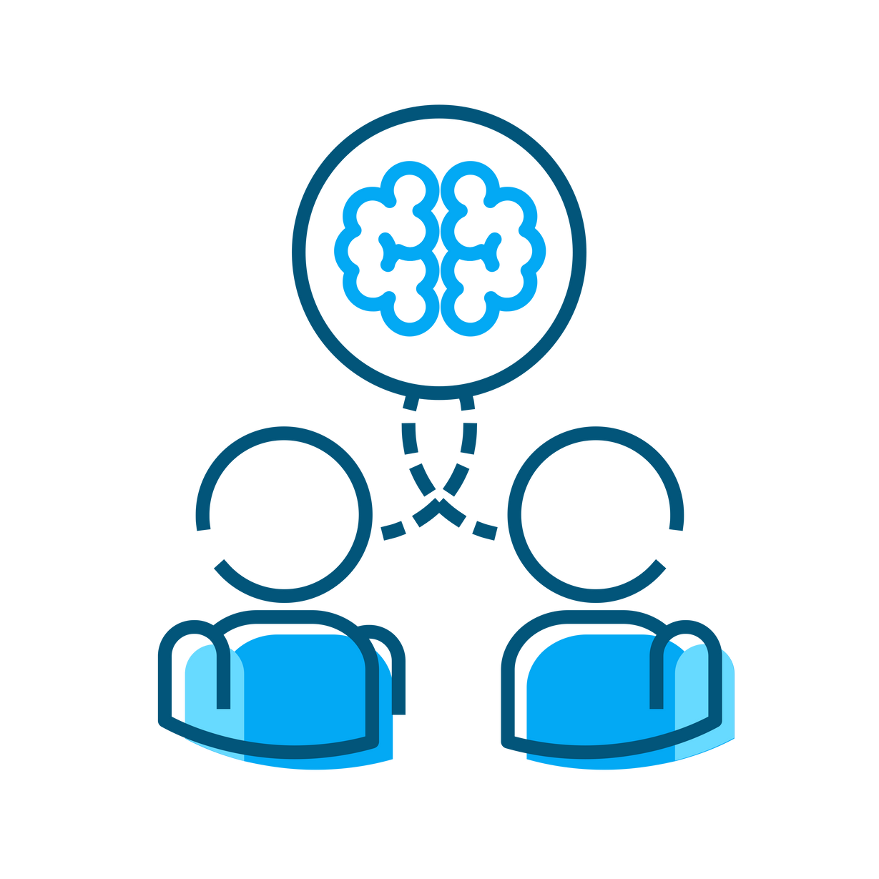
Taking Flight With Copilot
Virtual Pair Programmer
Code Acceleration
Code Exploration
Productivity
Bird, C., Ford, D., Zimmermann, T., Forsgren, N., Kalliamvakou, E., Lowdermilk, T., & Gazit, I. (2022). Taking flight with Copilot: Early insights and opportunities of AI-powered pair-programming tools. Queue, 20(6), 35-57. https://dl.acm.org/doi/pdf/10.1145/3582083
Notes:
2:00
Running: 16:30
Pair programming involves two developers working together, one acting as the "driver" who writes the code and the other as the "navigator" who guides and reviews the code in real time. This approach enhances code quality, readability and facilitates quicker code review. Historically, pair programming required complex coordination, making it challenging to adopt at scale. However, Copilot changes this paradigm. Copilot enables developers to code with the assistance of an AI pair programmer, revolutionizing the pair programming experience.
As a co-worker said, "This is like pair programming for introverts."
Copilot is used in two modes, code acceleration and code exploration.
In code acceleration mode, Copilot acts as a sort of intellisense on steroids, completing lines of codes seemingly reading the programmer's mind.
In code exploration mode, the developer can prompt Copilot with a comment to create larger code blocks. Exploration mode is useful when the developer works in an unknown space or learns a new language.
Copilot has been proven to be directly correlated to productivity as outlined in the SPACE Framework.

Slide 12



Copilot Drawbacks
Security Concerns
Code Quality
Lack of Defensive Code
  Research shows that generated code can have security violations
  More complex algorithms are more difficult for Copilot to generate
  Checking for null values and similar actions need to be added to some generated code
Dakhel, A. M., Majdinasab, V., Nikanjam, A., Khomh, F., Desmarais, M. C., & Ming, Z. (2022). GitHub Copilot AI pair programmer: Asset or liability?. arXiv preprint arXiv:2206.15331. https://doi.org/10.48550/arXiv.2206.15331
Pearce, H., Ahmad, B., Tan, B., Dolan-Gavitt, B., & Karri, R. (2022, May). Asleep at the keyboard? assessing the security of Github Copilot’s code contributions. In 2022 IEEE Symposium on Security and Privacy (SP) (pp. 754-768). IEEE. https://arxiv.org/pdf/2108.09293.pdf?nylayout=pc
Notes:
1:30
Running: 18:00
While there are many positives with Copilot, there are some drawbacks. For example, generated source code could have security vulnerabilities. Therefore, when using Copilot to generate source code, the developer will still need to review the generated code for best practices and possible vulnerabilities. Another point is that what is considered a best practice when the model was trained may no longer be regarded as a good practice when the code is generated due to the evolution of security concerns (Pearce et al., 2022).
In addition, code quality can be a concern. Copilot generates correct and optimal solutions for fundamental algorithms. However, more complex algorithms are more difficult for Copilot to generate. Code quality depends mainly on the conciseness and completeness of how the developer prompts Copilot. Prompts need to be detailed enough for Copilot to generate accurate completions.
Another drawback of Copilot is the lack of defensive code, such as error handling, input validation, checking for nulls, etc.
The key benefit of Copilot is that it gives the developer a good starting point for projects saving them time.

Slide 13
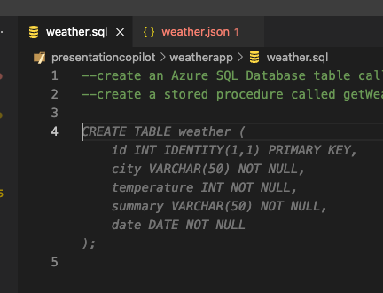

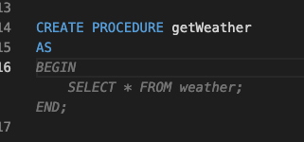
Results of Copilot Prompt in SQL
Notes:
Bonus Material
Here is an example of the create table script and the stored procedure to retrieve records that Copilot automatically generated with a simple prompt. The id column, which was automatically set up as the primary key and set up as an identity, is especially nice. The data types were suggested based on context, as well.
In addition, the stored procedure is auto-completed based on best practices. Once again, this eliminates mundane code creation by the developer and keeps them in their flow state.

Slide 14

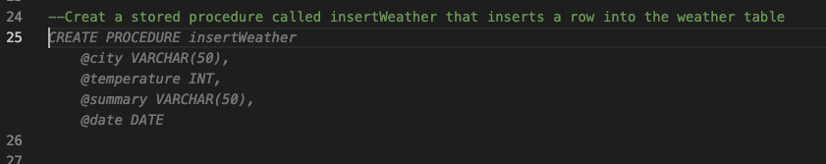
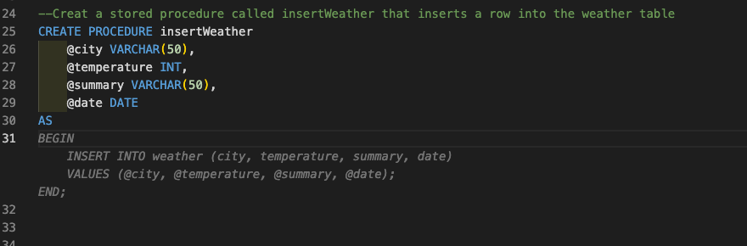
Results of Copilot Prompt in SQL
Notes:
Bonus Material
Continuing with the database objects, Copilot understands the developer needs a stored procedure to insert data and proceeds to suggest one. The developer only needs to hit the Tab key to accept the new stored procedure.

Slide 15
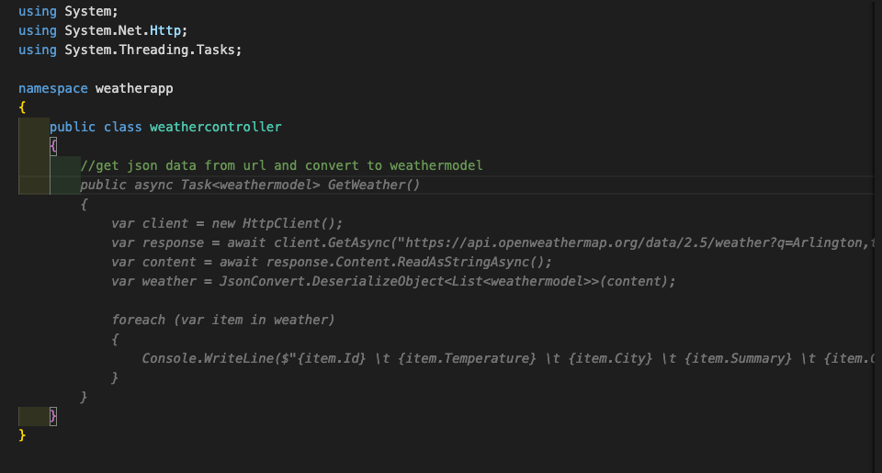
Using Copilot to Access REST API
Notes:
Bonus Material
Here is an example using Copilot in code-exploration mode. Typing in the prompt triggers Copilot to return a suggestion using HttpClient to access a REST API. The model isn’t perfect, but it gives us a good start when accessing the API. As you can see, based on the context, Copilot is smart enough to know we are using the openweather API. In addition, it knows we have a model named Weather and assumes we want to deserialize the content returned from the API call into an instance of that object.
This is a powerful prompt because it lets us create a lot of code in a short amount of time. Yes, we need to add defensive code and check for security holes, but the generated code is a great start.

Slide 16
Objectives
What is Copilot
How Copilot Works
The Building Blocks of AI Code Generation
Using Copilot as a Pair Programmer
Copilot Drawbacks
Copilot's Affect Developer Job Satisfaction
Is the Cake a Lie?
Notes:
1:00
Running: 19:00
Hopefully, you understand that Copilot is an AI-powered code generation tool trained on GitHub repositories.
We discussed the history of code completion and AI and how those ideas are combined to create Copilot.
From a hands-on perspective, you have seen Copilot used in SQL and C# for code acceleration and exploration.
You now understand why Copilot is referred to as a personal pair programmer and how it can perform some of the more mundane and tedious programming tasks for you.
Lastly, you have seen how Copilot can help you increase your job satisfaction.

Slide 17

Thank You & Happy Programming
GitHub | https://github.com/morgansgarage
LinkedIn | linkedin.com/in/scottmorgan7/
Email | s0m75431@marymount.edu
Twitter | twitter.com/ScottMorganMMU
YouTube | youtube.com/channel/UCGwXdLQf7T0e2J8M7hjkIiA
Web | www.morgans-garage.com/
Notes:
:30

Slide 18
References
Backus, J. W., Beeber, R. J., Best, S., Goldberg, R., Haibt, L. M., Herrick, H. L., ... & Nutt, R. (1957, February). The FORTRAN automatic coding system. In Papers presented at the February 26-28, 1957, western joint computer conference: Techniques for reliability (pp. 188-198). https://dl.acm.org/doi/pdf/10.1145/1455567.1455599
Bird, C., Ford, D., Zimmermann, T., Forsgren, N., Kalliamvakou, E., Lowdermilk, T., & Gazit, I. (2022). Taking flight with Copilot: Early insights and opportunities of AI-powered pair-programming tools. Queue, 20(6), 35-57. https://dl.acm.org/doi/pdf/10.1145/3582083
Barke, S., James, M. B., & Polikarpova, N. (2022). Grounded copilot: How programmers interact with code-generating models. arXiv preprint arXiv:2206.15000. https://doi.org/10.48550/arXiv.2206.15000
Chen, M., Tworek, J., Jun, H., Yuan, Q., Pinto, H. P. D. O., Kaplan, J., ... & Zaremba, W. (2021). Evaluating large language models trained on code. arXiv preprint arXiv:2107.03374. https://arxiv.org/pdf/2107.03374
Dakhel, A. M., Majdinasab, V., Nikanjam, A., Khomh, F., Desmarais, M. C., & Ming, Z. (2022). GitHub Copilot AI pair programmer: Asset or liability?. arXiv preprint arXiv:2206.15331. https://doi.org/10.48550/arXiv.2206.15331
Forsgren, N., Storey, M. A., Maddila, C., Zimmermann, T., Houck, B., & Butler, J. (2021). The SPACE of developer productivity: There's more to it than you think. Queue, 19(1), 20-48. https://doi.org/10.1145/3454122.3454124
GitHub (n.d.). Your AI pair programmer. Retrieved July 5, 2023, from https://github.com/features/copilot/

Slide 19
References
Hopper, G. M. (1952, May). The education of a computer. In Proceedings of the 1952 ACM national meeting (Pittsburgh) (pp. 243-249). https://dl.acm.org/doi/pdf/10.1145/609784.609818
Hou, D., & Wang, Y. (2009, November). An empirical analysis of the evolution of user-visible features in an integrated development environment. In Proceedings of the 2009 Conference of the Center for Advanced Studies on Collaborative Research (pp. 122-135). https://www.academia.edu/download/50933089/ide-evo-CASCON09.pdf
Liddy, E. D. (2001). Natural language processing. In Encyclopedia of Library and Information Science, 2nd ed. NY. Marcel Decker, Inc. https://surface.syr.edu/cgi/viewcontent.cgi?article=1043&context=istpub
McCarthy, J., Minsky, M.L., Rochester, N., & Shannon, C.E. (1955). A proposal for the Dartmouth summer research project on artificial intelligence. Stanford University. http://jmc.stanford.edu/articles/dartmouth/dartmouth.pdf
Mitchell, T. M. (2007). Machine learning (Vol. 1). New York: McGraw-hill. http://www.cs.cmu.edu/~tom/files/MachineLearningTomMitchell.pdf
Míšek, J. (2017). IntelliSense implementation of a dynamic language. https://dspace.cuni.cz/bitstream/handle/20.500.11956/94052/RPTX_2017_1_11320_0_564579_0_196610.pdf?sequence=1
Pearce, H., Ahmad, B., Tan, B., Dolan-Gavitt, B., & Karri, R. (2022, May). Asleep at the keyboard? assessing the security of Github Copilot’s code contributions. In 2022 IEEE Symposium on Security and Privacy (SP) (pp. 754-768). IEEE. https://arxiv.org/pdf/2108.09293.pdf?nylayout=pc

Slide 20
References
Sammet, J. E. (2000). The real creators of Cobol. IEEE Software, 17(2), 30-32. http://twinkie.homedns.org/Papers/Ovid-Journals/cobol-creators-00841602.pdf
Vaithilingam, P., Zhang, T., & Glassman, E. L. (2022, April). Expectation vs. experience: Evaluating the usability of code generation tools powered by large language models. Chi Conference on Human Factors in Computing Systems Extended Abstracts (pp. 1-7). https://dl.acm.org/doi/10.1145/3491101.3519665
Wolf, T., Debut, L., Sanh, V., Chaumond, J., Delangue, C., Moi, A., ... & Rush, A. M. (2020, October). Transformers: State-of-the-art natural language processing. In Proceedings of the 2020 conference on empirical methods in natural language processing: system demonstrations (pp. 38-45). McCarthy, J., Minsky, M.L., Rochester, N., & Shannon, C.E. (1955). A proposal for the Dartmouth summer research project on artificial intelligence. Stanford University. http://jmc.stanford.edu/articles/dartmouth/dartmouth.pdf
Xu, F. F., Vasilescu, B., & Neubig, G. (2022). In-ide code generation from natural language: Promise and challenges. ACM Transactions on Software Engineering and Methodology (TOSEM), 31(2), 1-47. https://dl.acm.org/doi/pdf/10.1145/3487569
Ziegler, A., Kalliamvakou, E., Li, X. A., Rice, A., Rifkin, D., Simister, S., Sittampalam, G. & Aftandilian, E. (2022, June). Productivity assessment of neural code completion. Proceedings of the 6th ACM SIGPLAN International Symposium on Machine Programming (pp. 21-29). https://doi.org/10.1145/3520312.3534864

