Slide 1
ElevenLabs – The Present and Future of AI Voice Technology
September 6th, 2023
Strictly Confidential - do not share
Notes:
Intro about Carles
We are here to talk about voice technology
We will do a bit of a demo

Slide 2
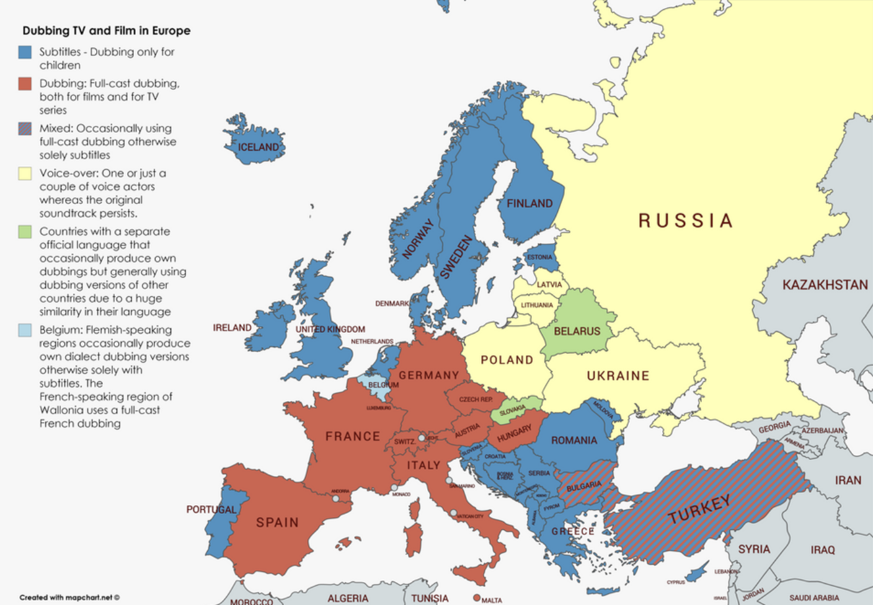
Company & Origins
ElevenLabs creates the most realistic, versatile and contextually-aware AI voices. We are the leaders in voice technology with our cutting edge research and products that enable our customers to generate content at scale.
Founders
Mati
CEO & Co-founder
Piotr
CTO & Co-founder
Strictly Confidential - do not share
Notes:
We are a pure AI research company
With the only goal of enabling our customers to generate content at scale
But it all started with the dubbing experience

Slide 3
Voice Research
Voice is the most natural and traditional form of communication.
We spent 18 months researching what makes a voice sound human.
Strictly Confidential - do not share
Notes:
Voice is the most natural and traditional form of communication.
We spent 18 months researching what makes a human voice sound human.
Sound human, natural
Be able to do dialogue and long narration
Contextually aware
Breaths and mistakes make a difference

Slide 4
What’s real?
One is the real Pep Guardiola… one is a clone
Strictly Confidential - do not share

Slide 5
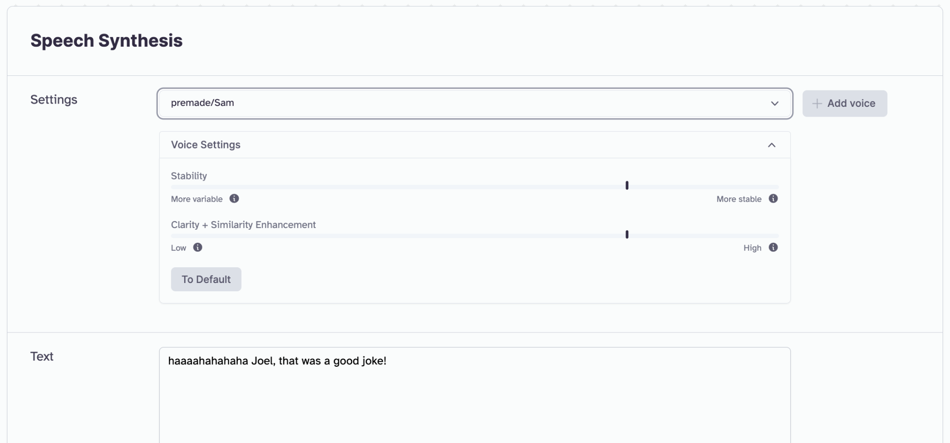
Our Product - Demo
ElevenLabs Studio
Manually craft content with our Studio and use the different settings to get the delivery you had in mind. The models will automatically analyse the content to give you a unique voice performance.
ElevenLabs REST API
Integrate ElevenLabs voice technology into any application or workflow with our REST API.
Strictly Confidential - do not share

Slide 6
Voice, Model, and Context Interoperability
Unlike other text to speech technology, our models work with any voice paired with any language, using any prompt or style.
Context
Voice
Model
Our models read and analyze the content of each prompt and decide what is the best way to speak the content - just like a real human.
Our models work with any voice, including: - Synthetic Voices designed in our VoiceLab
- Instant Voice Clones
- Professional Voice Clones
We currently have four models: - English and Multilingual V1
- English and Multilingual V2
Strictly Confidential - do not share
Notes:
Our voice research has been focused on generating high-quality and seamless content for gaming & entertainment studios
Context → contextual awareness
Voice creation → intant

Slide 7
The Journey To Date
Released support for 28 languages with Multilingual V2
Professional Voice Cloning released to the public
Released support for 8 languages with Multilingual V1
1,000,000+ active users
Projects - Our longform editor for articles and audiobooks - released in early access
Series A led by a16z & Nat Friedman
English V1 Launched!
Q1 2023
Q2 2023
Q3 2023
Q4 2023
Strictly Confidential - do not share

Slide 8
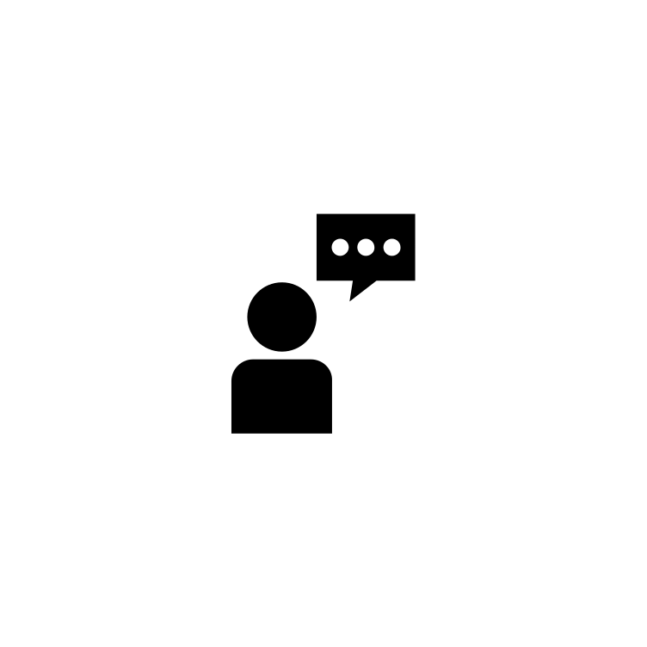
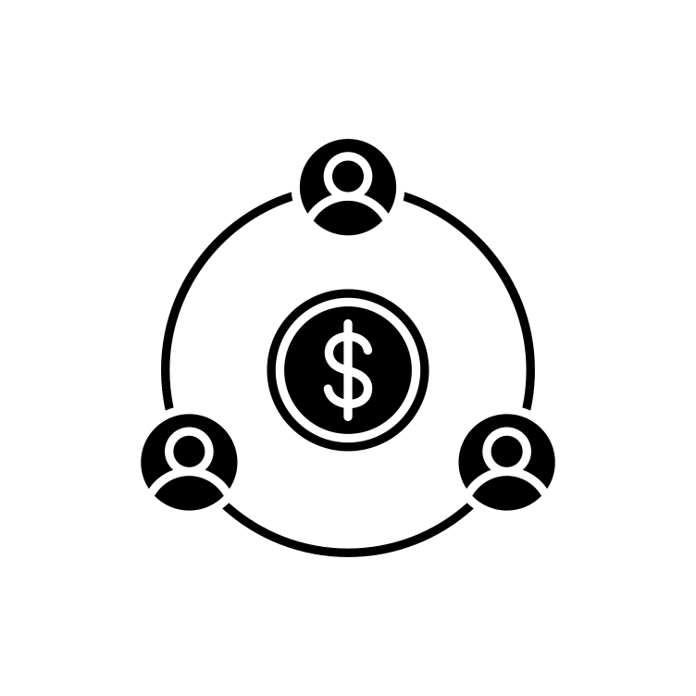
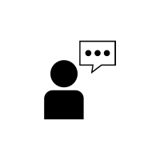
…And the Journey Ahead
Voice Conversion
Voice Marketplace
Convert recorded speech to a different voice
Provide a platform for voice talent to monetize their voices and performances at scale while facilitating control and safety.
Automated Dubbing
Take any recorded speech and convert it to any other language while maintaining speaker’s voice and quality of performance.
Strictly Confidential - do not share
Notes:
Voice conversion
Language models v2
Pacing controls
Styles & Prompts
HiFi audio & output
Dictionary
SSML
Director mode
New languages

Slide 9
Thank you!
Kevin Chu
Strictly Confidential - do not share

