Slide 1
Welcome to our demo
Meet the Wysdom Operations Center: chatbot analytics software

Slide 2
Agenda
Presenter
Meet Wysdom
Bot team challenges
Live demo
Jay Athia
Sr. Director, Customer Success
jay.athia@wysdom.ai
Notes:
Credibility
Jay personal - 5+ years managing and analyzing bots. Lots of platforms, voice, mobile. Finding and fixing the most trivial problems and the most complex, learning along the way to refine a process to help find the most impactful issues, forecast them, release and measure.

Slide 3
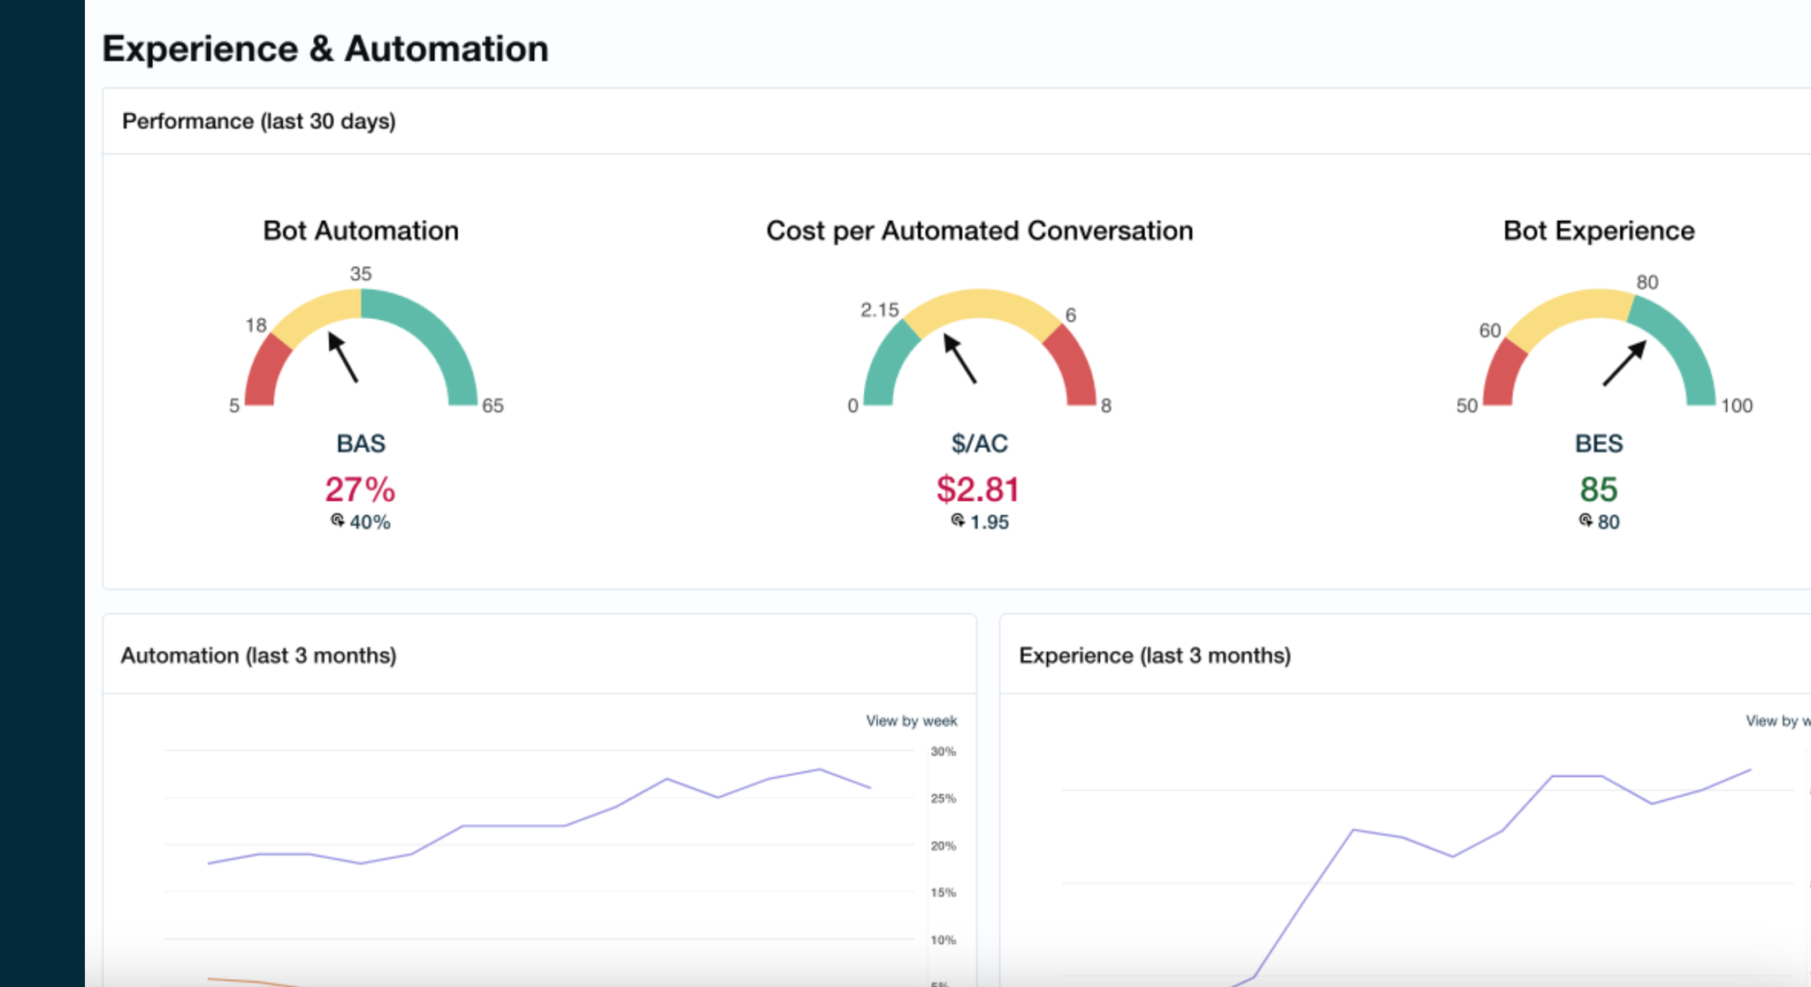
Fast track bot improvement with Wysdom
Chatbot Analytics software
Chatbot services
Dozens of happy customers
Notes:
Talking points
Thanks for joining me today.
First a bit about us.

Slide 4
The bot isn’t
living up to expectations
Not meeting containment goals
Contact center volume still growing
I can’t get resources
It’s the wrong platform for our needs
Notes:
Rephrase problem
You probably got a bot platform, expected the latest tech to automate and it’s not living up. Task completion or containment isn’t there. Contact center volume isn’t letting up -- and the platform gets blamed on being too difficult or lacking features. You find new use cases to add to it,and that gets a bit more ROI, but that too stagnates as there are no resources for additional integrations or new channels like voice.
Emotional impact
Execs aren’t thrilled, they start getting distracted by a new technology that might solve the problem. You are trying to keep the bot running well and proving your worth.

Slide 5
Chatbot analytics demo

Slide 6
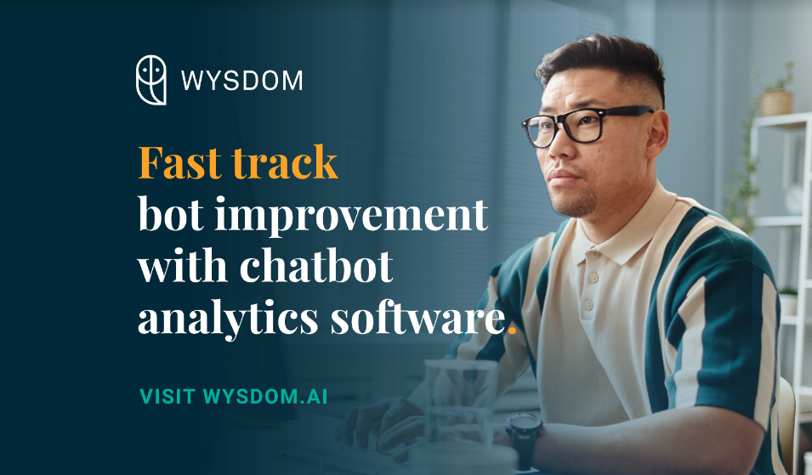
Find us at the show … and after!
Booth visit
# 416
Webinar
Sep 13 @ 2:00 ET
wysdom.ai

Slide 7
www.wysdom.ai
sales@wysdom.ai
linkedin.com/company/wysdomai
Notes:
talking points:
so, that’s a wrap for me, hope you learned something today.
I wanted to invite you to check out our website, but more importantly, find us on LinkedIn search for Wysdom AI (Wysdom with a Y), and follow us.
The Team has been putting out a lot of content about bot analytics that you might find quite interesting. We’ve recently started a topic around LLMs talking about how ChatGPT, Bing and so on, about these latest trends.

