Slide 1
Generative and Conversational AI Transforming Everyday Experiences
Voice & AI
Presented by
Raj Koneru – CEO and Founder, Kore.ai

Slide 2
Our Story…
2

Slide 3
The Trusted Leader in Conversational AI
to Automate and Optimize Global Enterprise Customer and Employee Experiences
400+
200m+
2m+
15%-80%
$2b+
Fortune 2000 companies Top 4 banks Top 3 healthcare
Enterprise consumers interacting with Kore.ai technology
Employees use Kore.ai IVAs to automate 1 billion plus interactions across 35+ channels
Automation Rates based on use case
In cost reduction delivered to customer operations since 2015
Financial Services
Pharma & Healthcare
Consumer & Retail
Telcom & Media
Other Businesses
Notes:
Leading Companies Trust Kore.ai Technology to Automate and Optimize Their Customer and Employee Experiences
Since 2014, we’ve been working with global 2000 industry leading companies helping them transform their customer, employee and agent experiences. Using Kore.ai technology platform and solutions, our customers have built virtual assistants to improve various business operations.
[Cover the stats…200+ customers, 100m+ Enterprise consumers, 1m+ employees use Kore IVAs, 15-75% Automation rates, $ 1b+ in cost reduction.]
[Lastly, cover the verticals and customers]
Here you see companies across multiple verticals that leverage and trust Kore.ai solutions every day.
[Others to mention…
Financial Services
Metlife
Fulton Banks
Assurant
Bank Millennium
Banco Sabadell
Gerber FCU
IDFC Bank
NOVA Bank
PSCU
PostFinance
TIAA
Pharma & Healthcare
Mercy Health
Kaiser Permanente
KonicaMinolta
Medline
Otsuka
Teva
Consumer & Retail
Columbia Sportswear
Living Spaces
Michelin
McDonalds (UK)
Samsung Electronics
Sunvend
Other Businesses
State of Florida
State of Tenn
Hermes
Manpower
NetApp
Autodesk
AgcoCorp
Siemens
Thomson Reuters

Slide 4
The Dawn of Generative AI
Notes:
Given that more than 80% of routine business interactions between customers, employees and processes drive their overall experiences, it is important to understand what Kore.ai defines as Experience Optimization.
[Read/summarize quote]
Delivering extraordinary experiences for customers, employees, and agents across voice and digital channels using AI-native automation and augmentation resulting in extraordinary business outcomes.
This means that with Kore.ai technology, you can drive superior experiences for your customers and internal employees (agents too!) leveraging conversational AI and automation.
Advanced AI-first technology, when deployed correctly, enables businesses to harness conversational interactions with greater efficiency and at reduced costs while ensuring the highest customer, employee, agent and partner experiences. Ultimately, companies can have complete control over the user experience with real-time information, nudges and alerts.

Slide 5
The Conversational AI Market
Conversational AI Market Size
In Billions$
81.68
80
Gartner estimates the 2021 conversational artificial intelligence platform market is $3.8 billion, growing 55% year over year.
60
52.70
55% Year-Over-Year Growth in Conversational AI Market
40
34.00
21.93
20
14.15
9.13
3.80
5.89
0
2021
2022
2023
2024
2025
2026
2027
2028
Source: Competitive Lanscape - Conversational AI Platform Providers, ‘22

Slide 6
Big Predictions with GenAI…
Investment in generative AI will lead to a 20% to 30% reduction of customer service and support agents, and will create new jobs to enable generative AI in these functions ~ Gartner
38% of leaders see improving customer experience and retention as the primary purpose of initiatives to deploy applications trained on large language models. ~ Gartner
e-Commerce will generate 30% of sales via voice commerce by 2030; this undoubtedly emphasises the future trend to the adoption of Voice AI technology. ~Deloitte
30% of organizations adopting conversational AI will want responsible AI practices or techniques, up from less than 5% in 2022.
30% of outbound marketing messages from large organizations will be synthetically generated.
The McKinsey report indicates that Generative AI applied in customer care could increase productivity from 30 to 45 percent based on current operation costs.
Source: Gartner Emerging Tech Impact Radar: Conversational Artificial Intelligence

Slide 7
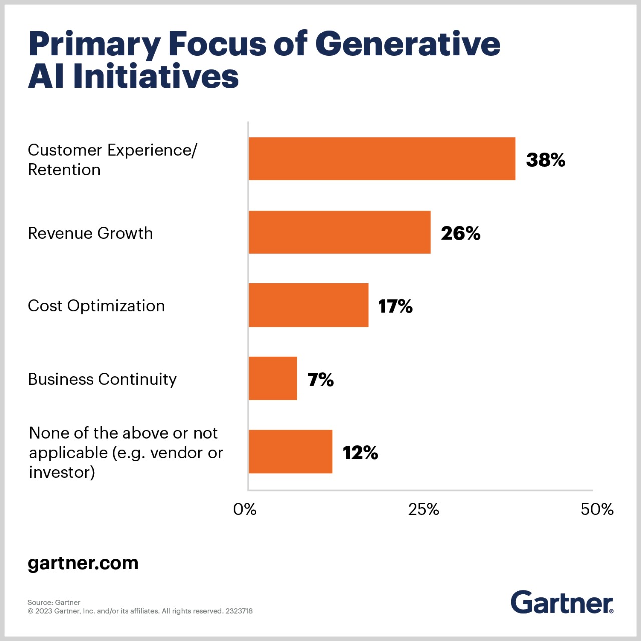
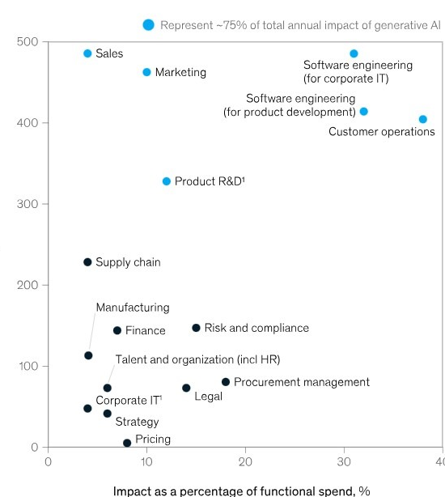
Primary focus of Generative AI Initiatives
Impact $Billion
McKinsey

Slide 8
It’s more than a chatbot…
It can…
Classify
A customer-care manager can use generative AI to categorize audio files of customer calls based on caller satisfaction levels.
Edit
A copywriter can use generative AI to correct grammar and convert an article to match a client’s brand voice.
Summarize
A business analyst can create a Venn diagram that summarizes key points from an executive’s presentation.
Answer
A patient can ask a chatbot questions about how to best repspond to a health situation.
Generate
A software developer can prompt to create entire lines of code or suggest ways to complete partial lines of existing code.

Slide 9
Large Language Models
Summarize the Wikipedia synopsis of Romeo & Juliet (~1,200 words)
The technology behind ChatGPT; receiving much media attention lately
Modern computers and algorithms allow capturing statistics from extremely large text corpora
Can be used to facilitate language understanding
Particularly helpful for generating and transforming texts
In 20 words:
Two young lovers from feuding families are forced to make tragic choices that ultimately lead to their deaths.
In 10 words:
Star-crossed lovers take tragic actions that end in death.
In 5 words:
Love, hate, and death
In 2 words:
Love kills

Slide 10
Big Shift in Speech/Voice AI Tech with LLMs/GenAI...
FROM OLD
TO NEW
ASR/TTS
Rule based User Intent Understanding/ Rudimentary Programmatic Voice Responses
ASR/TTS
Better user voice recognition / Natural, Human-like Voice Responses
Powered by Audio, LLMs & GenAI

Slide 11
Three Prominent Use Cases for Voice AI Automation
Self Service Automation
Agent Assistance
Outbound Calling

Slide 12
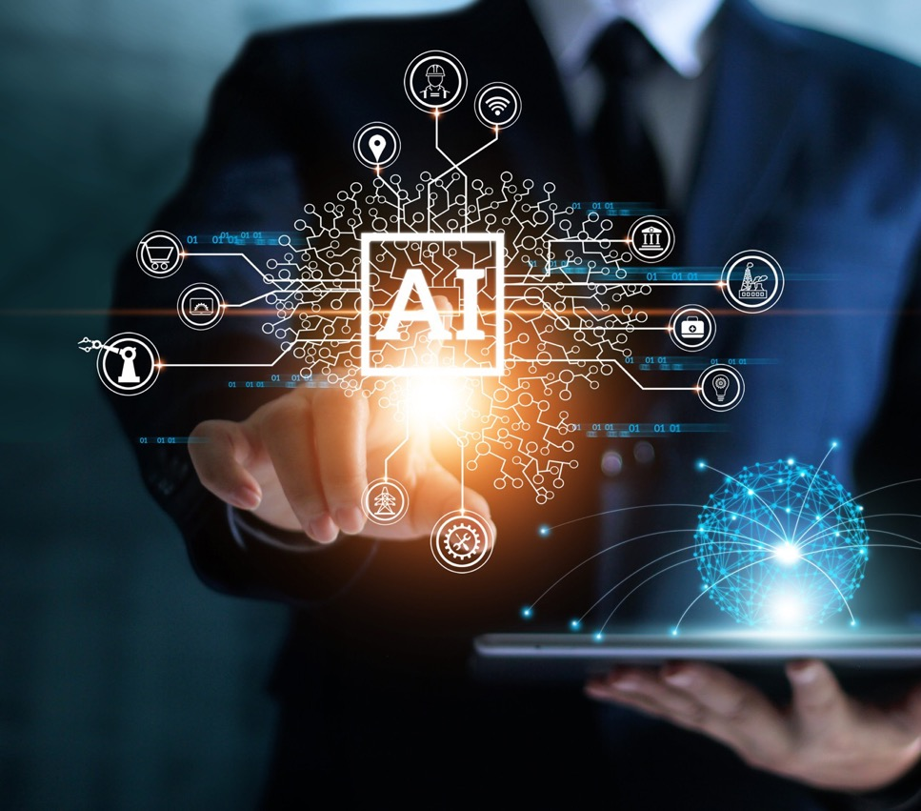
Our Approach and Strategy “Better Together”

Slide 13
Generative Language Models & Conversational AI Platforms
Better Together
Generative Language Models
Conversational AI Platforms
Together they offer incredible benefits
Better Understanding
Higher Accuracy
Improved Efficiency
Complete Flexibility
Faster Time-to-Market

Slide 14
Leveraging Large Language Models & Generative AI
Better Together
Smart Copilot
For IVA Development
Dynamic Conversations
Based On Generative Language Models
Advanced Analytics
Powered By Generative Language Models
Use Case Suggestions
Conversation Preview & Auto-dialog Generation
Training Data Suggestions
NLU Test Data Suggestions
Zero-Shot Learning Model
Few-Shot Learning Model
Knowledge AI
AI-Assisted Adaptive Dialog
Dynamic Paraphrasing
User VA Conversation Insights
Intent Discovery
Agent Performance Insights
Quality Management Insights
Agent Customer Interaction Insights

Slide 15
Gen AI Dialog
Gen AI Dialog
Knowledge Retriever
Contextual
Chain of Prompting
LLM - 1
Candidate knowledge
LLM - 2
Response Evaluator
Retrieve JSON or Response
Candidate Intents
LLM - 3
Intent Model
Bot user conversation
User context
Business rules
Exit criteria
Few shot examples
Prompt template model
Generative Prompts
Context specific few-shot examples
Business rules
Send response to user

Slide 16
Food Solutions Demo

Slide 17
Gen AI Dialog
Input
Prompt template selection
Prompt 1
Use context
Select few shot examples
Conversation context
Build chain of thought reasoning examples for business rules and exit criteria
LLM - 1
Business Rules
LLM - 2
Response
Prompt 2
Exit criteria
Populate conversation context
LLM - 3
Populate user context
Response Evaluator
Few shot examples
Candidate knowledge
Generate prompt based on context
Retrieve JSON or Response

Slide 18
Multiple Model Orchestration - Retail Assist
Model Number
Questions on Warranty
Questions from User Manual
Product Installation Questions
Product support
Zendesk Ticketing
Troubleshooting questions
“My TV is blinking”
“Unable to connect share the phone screen on TV”
Sales questions
Product Search and Recommendations
“I want to buy top loading washing machine under $100 for a family of 5”
“What about front loading?”
Route to Salesforce Chat
Order or Delivery Questions
Curated Support FAQs
“How do I check order status?”
Transfer to human support
Route to Chat Support
Talk to Agent
“I want to talk to an agent”
General Knowledge
“What is OLED?”

Slide 19
Multiple Model Orchestration - Retail Assist
Input
Query Rephrasing
Few-shot Intent Model
(MPNet, Ada)
Entity Extraction Model + Entity Resolution
Follow-ups
Filter Products with Embeddings
Answer Generation Model
Zero-shot Intent Model (Open AI, Anthropic, PaLM 2)
Query Knowledge Embeddings Model
Enterprise Data APIs
Product Data Embeddings
Support KB Embeddings

Slide 20
Orchestrating multiple LLMs for conversational AI
User Input
Language Detection
“How many deals did I close?”
Language Detection
Spell Correction
Sentiment Analysis
Spell Correction
LaBSE
Deep Learning Model
RoBERTa
“necesito restablecer mi contrseña de O365”
Sentiment Analysis
“What knd of coverage is there for dental?”
MP Net
T5-FLAN
Find the type of the intent
Universal Bot – Bot Identification
LLaMA 2
With Few-shot examples
Knowledge base query
Transactional dialog intent
Query into Data and APIs
Intent Recognition
Identify intent and Integration
Entity Prompt Selection
Dynamic Entity Context
Kore Entity Processor
Entity Extraction
Enrich Context for Entity Prompt
Entity Order Processing
Open AI
Entity Extraction
Entity Extraction
Deep Learning Model
Generate Conversation Response

Slide 21
Orchestrating multiple LLMs for conversational AI
Generate Conversation Response
Knowledge base query
Transactional dialog intent
Query into Data and APIs
Contextual Prompt Generation
Open AI
T5-FLAN
Generate Dialog for Disambiguation
Generate Dialog for Disambiguation
Generate Dialog for Disambiguation
Contextual Chunk retrieval
LLaMA 2
MP Net
Retrieve Candidate Knowledge Segments
Execute Dialog Logic
Build Action
Ex. Call HubSpot API
Retrieval augmentation
Vector Database
Build Response Context
Filter Results
Filter irrelevant results using business rules
Select Response Prompt
Select Response Prompt
Select Response Prompt
Enrich Response Context
Enrich Response Context
Enrich Response Context
Generate Contextual Response
Open AI
Generate Response
Generate Response
Kore Fine-Tuned Model
Generate Response
Validate Response
Open AI
Validate Response
Validate Response
Validate Response
Kore Fine-tuned model

Slide 23
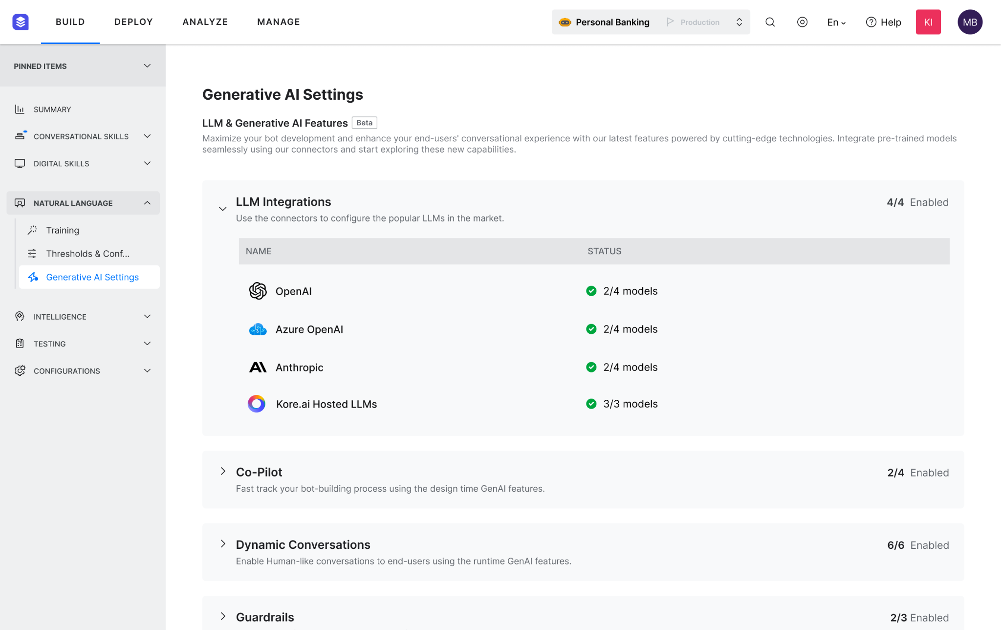
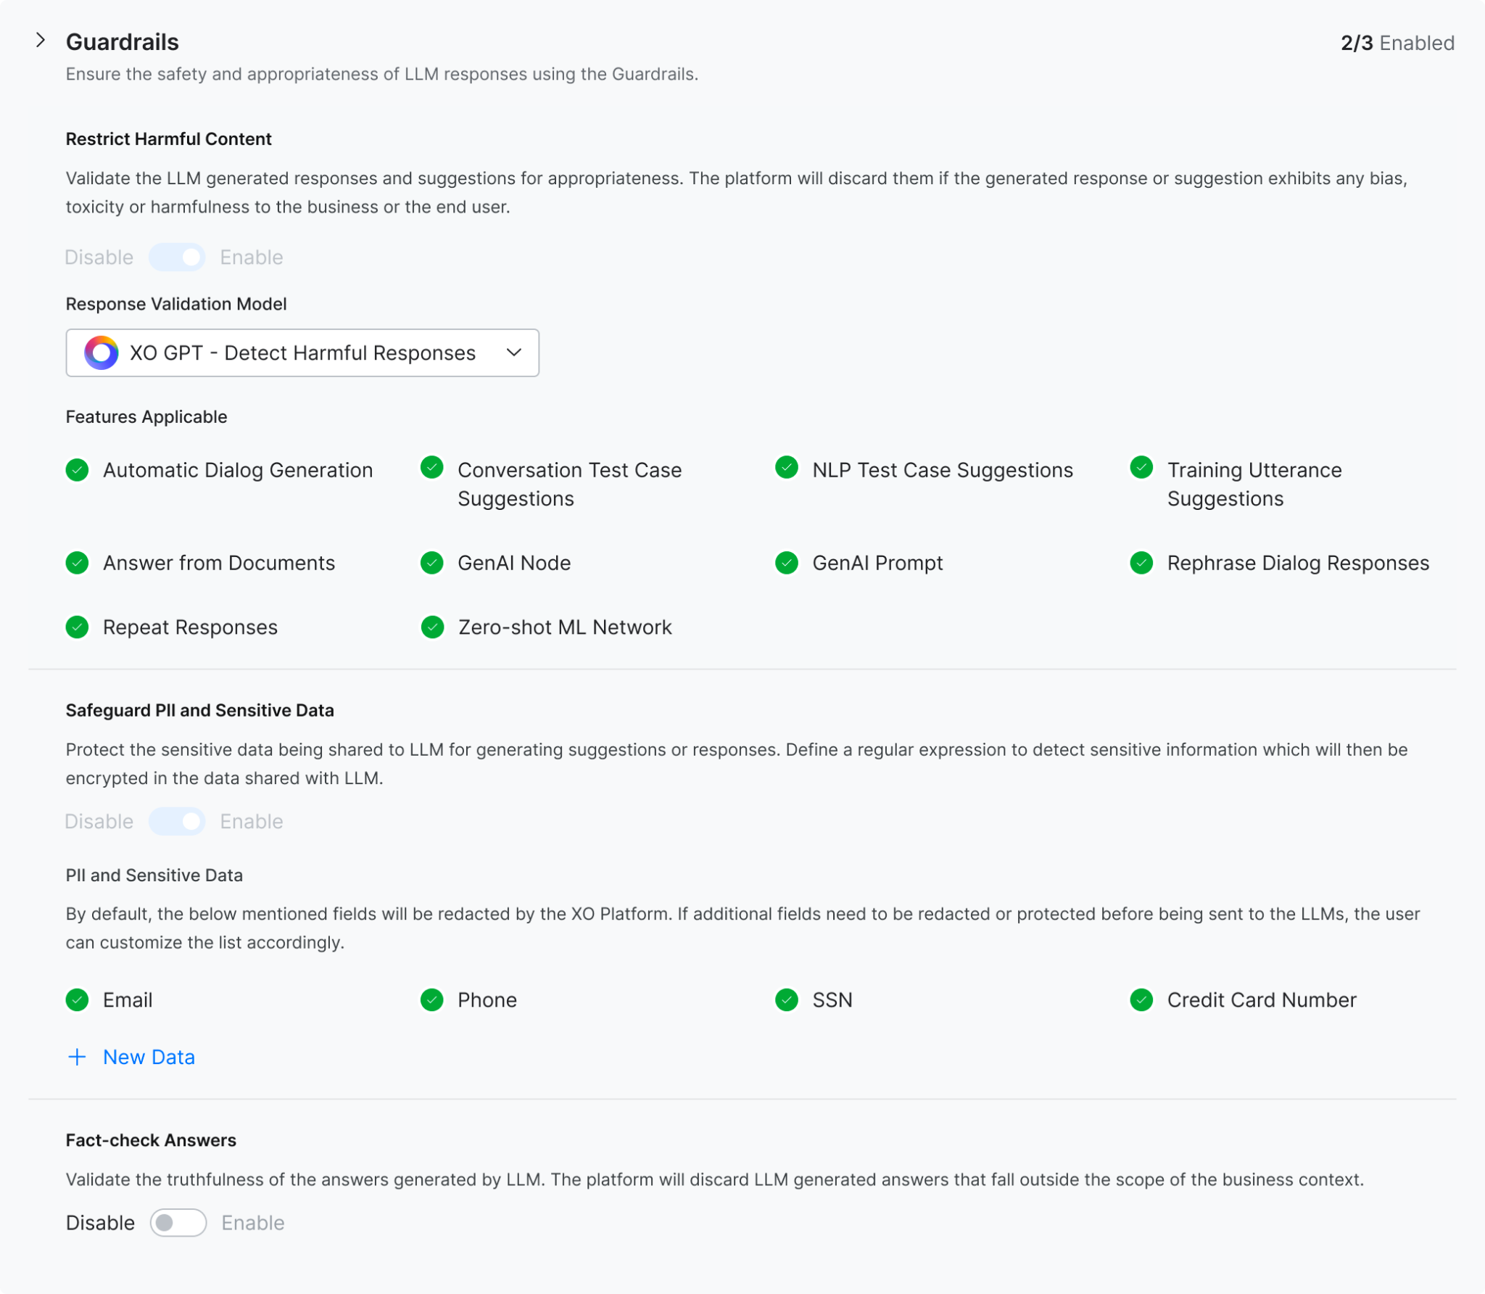
XO Platform Guardrails for using Pre-trained LLMs

Slide 24
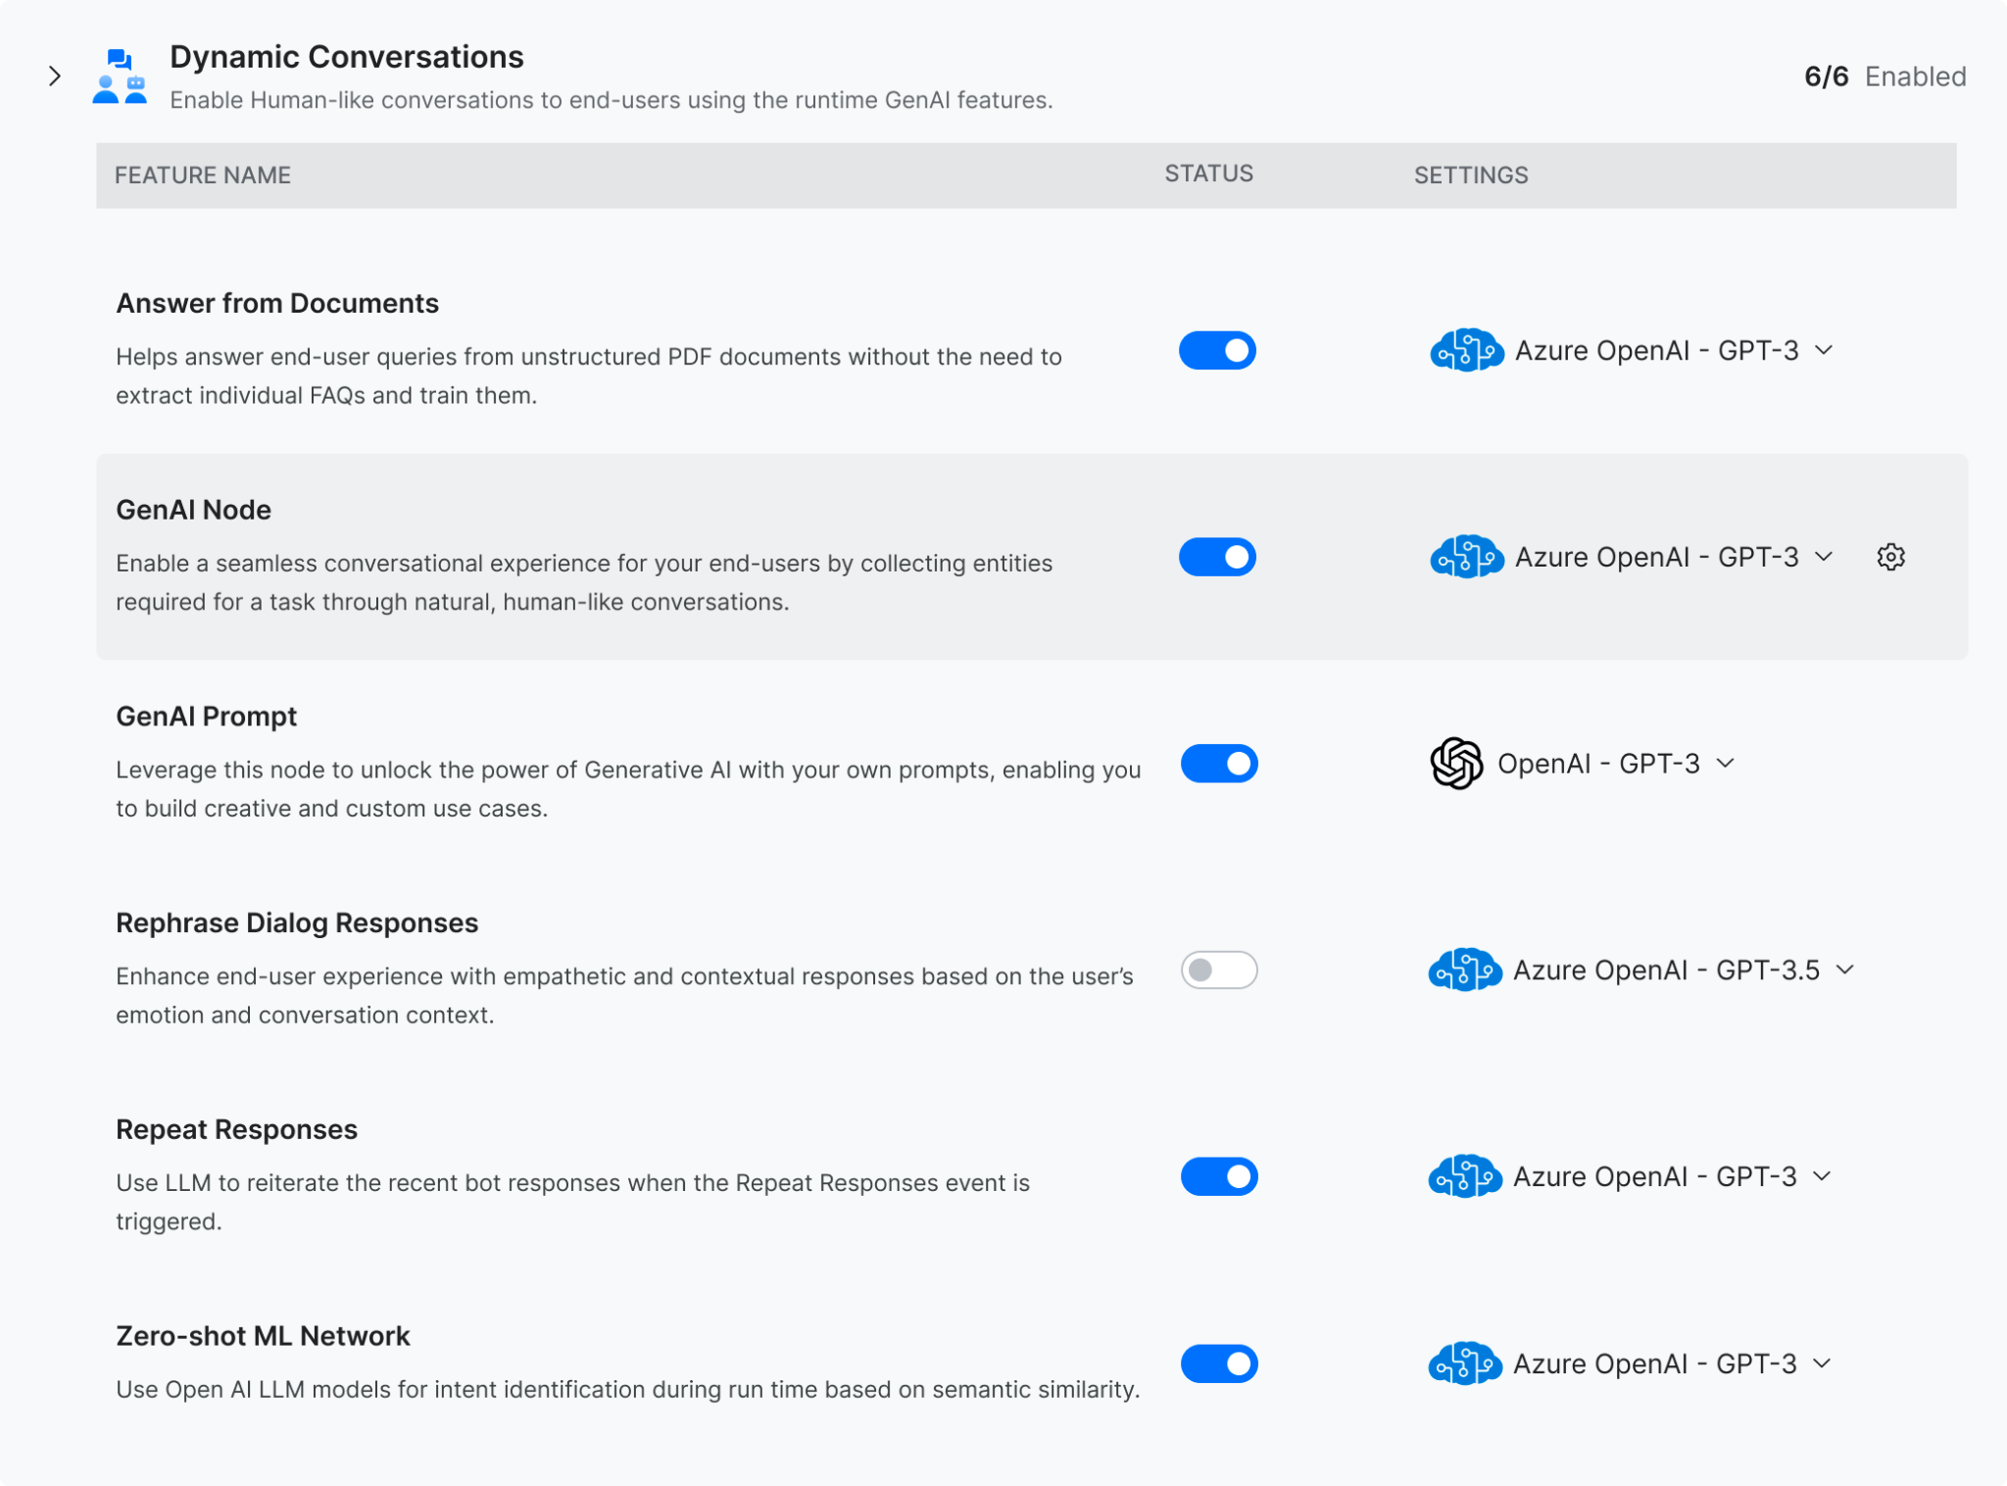
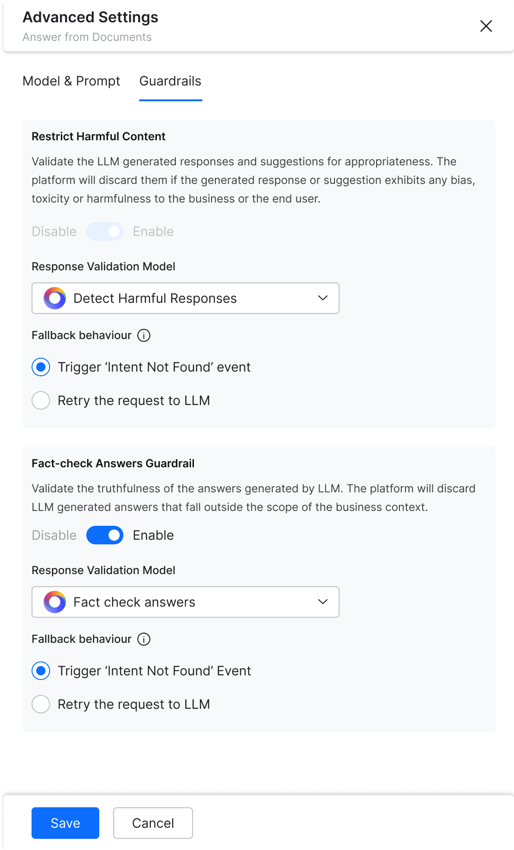
XO Platform Guardrails for using Pre-trained LLMs

Slide 25
XO Platform Responsible AI Framework
Needs | Description | Platform Features
Transparency | Explain what the bot can do and cannot do | Conversational Flow Designer Custom Welcome experiences
Inclusive Experience Design | No Bias or Toxicity in the bot responses | Guardrail Framework
Mitigate Hallucination | Make sure the model is grounded to factual knowledge and enterprise business rules | Retrieval augmentation Context management Validation Guardrails
Know Model Limitations | Understand what the model can do and cannot do | Multiple model orchestration Model Testing tools Model Fine Tuning tools
Governance and Audit Trails | Apply governance on how the model is used, and keep track of all the updates made to the model | Interaction logs Detailed audit logs
Rigorous Testing | Test the model continuously for accuracy, bias for various scenarios | Unit testing Conversation regression testing Model health reports
Monitor and Iterate with Updates | Monitor rigorously and iterate fast with updates to improve the model accuracy | Feedback collection framework Custom dashboards Bot performance reports Tools to selectively deploy updates

Slide 26
US Office Address
India Office Address
UK Office Address
Mail Us
Follow Us
7380, West Sand Lake Road Suite 390 Orlando, FL 32819
3rd floor, Aurobindo Galaxy Towers,
Opp. IKEA, Hi-Tech city, Madhapur,
Hyderabad – 500081
Alpha House, 100 Borough High Street London, UK SE1 1 LB
info@kore.com
Notes:
Next steps…
-Request a personalized demo customized for your industry and specific use cases
-Explore unlimited possibilities @ Kore.ai for every industry, every function, every use case
-Get started today with our no code, easy to use platform and experience it for yourself

Slide 27
Generative AI Use Cases
Consumer Use cases
Enterprise Use cases
Information & Knowledge: Get Answers, explanation, definitions
Product recommendations
Creative writing and storytelling
Personal Assistance: Reminders, To-dos
Entertainment & fun: Casual conversation, jokes, text based games, etc
Learning & education: Explain concepts, provide examples, etc
Language practice: Language conversation, translation, grammar, etc
Customer service virtual assistant
Personalized sales and marketing
Content Generation, summarization
Data Augmentation, sorting, categorization
Code generation, review, error correction
Simulation, prototyping & scenario planning
Risk assessment and fraud detection
Natural language understanding
Design & creativity - New ideas, Images, UIs
R&D - Analyze large datasets, generate hypotheses, identify patterns, insights and breakthroughs
Challenges - Data Security/Privacy, Response Customization, Hallucination, Missing Guardrails

