Slide 1
Conversational AI Business Risks and Tactics
Michael Novak
Sr. Responsible AI Advisor, Open Voice Network
NIST Generative AI Work Group
7 September 2023

Slide 2
Conversational AI Business Risks and Tactics agenda
Conversational AI Defined
Market Position
Risk Management
Governance, Frameworks, Assessments

Slide 3
Conversational AI defined
Human-to-Machine Communication Via Voice Or Written Text
Voice, Text, Code, Image, Video
Directed Prompt Chatbots
Rules-based programming to identify keywords and conversation slot variables and execution paths
Deterministic procedural solution
Generative Prompt Chatbots
Transformer trained to uncover and learn complex patterns using probabilities.
Dynamic statistical model. Accuracy improves over time and multiple turns.

Slide 4
Directed vs Generative Prompts
Play Jeopardy
Find my favorite restaurants
Play Twenty Questions
Play Restful Ambient Noise
How many quarts in a gallon?
Tell me a dog fact
Get high tide Seattle from Tide Pooler
Play the Dave Ramsey Show
What's in the news?
Start my car with PIN 1234
Summarization - Summarize following conversation between service rep & customer in few sentences. Use only info from conversation.
Writing - Write 3 paragraph email asking Peter whether or not he’s received Financial Planning rpt memo I sent lst wk.
Analysis - Which of our products gaining most traction in France ?
Classification - Louis van Gaal: In following article what is sentiment - positive or negative?
Extraction - Answer question based on context below. Extract exact
full sentence that contains answer. If question can’t be answered using info provided answer with "I CANNOT find governing law“

Slide 5
1. Market Position

Slide 6
Conversational AI Market Position
Risks
Tactics
Executive Level Visibility
- Educate, Advocate, Integrate with RoB
Budget
- Identify Operational Cost Savings ( $ or %)
Convenience, Multitasking, and Accessibility
Competition
- Marketing Intelligence Program,
MSP, ISV Partner Ecosystem, Customer Research
Strategy
- Where to compete
- How to create and capture economic value
- Conversational AI Value Chain
(Hint: Use Chatbot to ideate…)

Slide 7
Conversational AI Value Chain
Services (Azure CogSvc, Watson ML, SFDC Einstein GPT CRM, Exscientia Pharma, others)
Specialized Conversational Al knowledge (e.g., training, feedback, reinforcement learning)
Applications (Harvey Legal, TikTok, Translators, Spotify, ZenDesk, Avast, others)
B2B or B2C products that use FM’s as is - or fine-tuned to use cases
Model Hubs and MLOps (Hugging Face, TensorFlow, MSFT, others)
Tools to curate host, fine-tune, or manage FM (e.g., storefronts between apps & FMs)
Foundation Models (FM) (GPT-3, Stable Diffusion, CLIP, DALL-E, Codex, OSS, others)
Core models on which Conversational AI applications can be built
Cloud Platforms (AWS, MSFT, GCP, others)
Platforms that provide access to computer hardware
Computer Hardware (NVIDIA, IBM, Intel, Cambricon Tech, others)
Accelerator chips optimized for training & running models

Slide 8
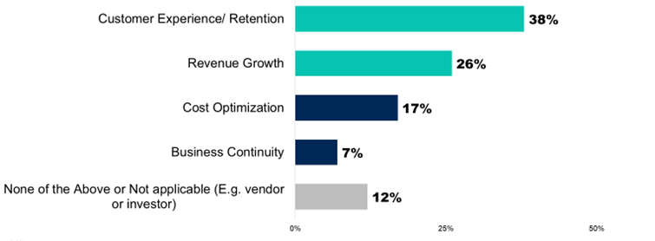
Conversational AI 2023 Investments Focus
Customer Experience/Retention
Revenue Growth
Cost Optimization
Business Continuity
None of the Above or Not Applicable (e.g., vendor or investor)
2023 Poll. n = 2,544. Does not represent global findings or market as a whole.
Notes:
https://www.gartner.com/en/newsroom/press-releases/2023-05-03-gartner-poll-finds-45-percent-of-executives-say-chatgpt-has-prompted-an-increase-in-ai-investment March & April 2023 online poll. n = 2,544. Does not represent global findings or market as a whole.

Slide 9
2. Risk Management

Slide 10
Conversational AI Cybersecurity Risk Poll
51% - Predict we’re less than a year away from ChatGPT cyberattack
3/4 - Believe foreign states are already using ChatGPT for malicious purposes against other nations
73% - Acknowledge AI as potential cybersecurity threat
Are either very or fairly concerned
2023 BlackBerry Survey 1,500 IT decision makers in NA, UK, Australia
Notes:
https://www.cpomagazine.com/cyber-security/ai-for-an-ai-why-chatgpt-is-a-double-edged-sword-for-cybersecurity/

Slide 11
AI Threat Model Taxonomy (abridged)
Spam/Harassment
Online Influence Campaigns
Malware/Social Engineering
Exploiting AI Authorship
Notes:
Machine Generated Text: A Comprehensive Survey of Threat Models and Detection Methods
https://arxiv.org/pdf/2210.07321.pdf

Slide 12
Mitigation AI spam/harassment
Spam/Harassment
- Comment Floods
- Mass Mail Lists
- Doc Submission Floods
Risk:
Federal Public Comment website. GPT generated +1K garbage comments: 55.3% of all comments
Spam is so pervasive and visible, may cause decrease in public trust
Mitigation:
- Verify “Human” prior to allowing posts or messages. Prioritize automation of delivery (volume, IP range, timing), rather than machine generated text
- To reduce automated submissions, combine pre-screen of content based on likelihood of being machine generated + CAPTCHA challenges + posting delay
(Hint: Use Chatbot to analyze & test…)
Notes:
Machine Generated Text: A Comprehensive Survey of Threat Models and Detection Methods
https://arxiv.org/pdf/2210.07321.pdf
Max Weiss. 2019. Deepfake bot submissions to federal public comment websites cannot be distinguished from human submissions. Technology Science (2019). https://techscience.org/a/2019121801/
US Govt CDO Council Federal Register Comment Analysis NLP Pilot2021 https://www.cdo.gov/news/comment-analysis

Slide 13
Mitigation ai Malware/Social Engineering
Risk:
- Able to generate dynamic, target-specific texts
- Detection systems challenged due to unique or highly-varied AI content
Mitigation:
- Automated Detection Systems
- Multi-Factor Authentication (voice + token)
- Reward User Reporting
- Awareness Campaigns
- Payload Content - stable detection flag
Malware/Social Engineering
- Phish – Deepfake Voice
- Phish - Email/SMS/Chat
- LLM Model Poisoning
- Malicious Chatbots, Chatrooms
(Hint: Use Chatbot to analyze & test…)
Notes:
Machine Generated Text: A Comprehensive Survey of Threat Models and Detection Methods
https://arxiv.org/pdf/2210.07321.pdf

Slide 14
Mitigation exploiting ai authorship
Risk:
- Reputational: Publication standards questioned
- Failure to master educational material
- Overwhelm target with fraudulent multimedia submissions
Mitigation:
- Train with Differential Privacy – Add data noise to mask individual’s data attributes
- Curate Data Prior to Training - Limit PII
- Limit Impact on downstream apps. Fine-tuning may cause LLM to “forget” data
- Audit the Models – Set privacy level baseline
Exploiting AI Authorship
- Science Pubs
- Job/Permit/Grant App Letters
- Social Media Content and IP
- Mass Articles Op Eds
(Hint: Use Chatbot to analyze & test…)
Notes:
Machine Generated Text: A Comprehensive Survey of Threat Models and Detection Methods
https://arxiv.org/pdf/2210.07321.pdf

Slide 15
Mitigation ai online Influence campaigns
Risk:
- 85% of the time, Users accept LinkedIn connection requests from deepfake profiles
- Most users make up their minds – by headlines only
- Average users overly trusting of online profiles with conversational AI generated photo & text
Online Influence Campaigns
- Commercial Promo / Reviews
- Political Disinfo / Propaganda
Mitigation:
- In person Chat Room platform moderation (Human in the Loop)
- Content amplification: machine-generated text detection of inauthentic activity
- Context-based detection: username patterns, acct. creation times, unusual behaviors, registered phone and IP address
(Hint: Use Chatbot to analyze & test…)
Notes:
Machine Generated Text: A Comprehensive Survey of Threat Models and Detection Methods
https://arxiv.org/pdf/2210.07321.pdf
Jaron Mink, Licheng Luo, et al . 2022. DeepPhish: Understanding User Trust Towards Artificially Generated Profiles in Online
Social Networks. In 31st USENIX Security Symposium (USENIX Security 22). USENIX Association, Boston, MA, 1669–1686.
https://www.usenix.org/conference/usenixsecurity22/presentation/mink
Maksym Gabielkov, Arthi Ramachandran, et al . 2016. Social Clicks: What and Who Gets Read on Twitter?. In ACM SIGMETRICS / IFIP
Performance 2016. Antibes Juan-les-Pins, France. https://hal.inria.fr/hal-01281190
American Press Institute. 2014. How Americans get their news.
https://www.americanpressinstitute.org/publications/reports/survey-research/how-americans-get-news/

Slide 16
3. Governance, Frameworks & Assessments

Slide 17
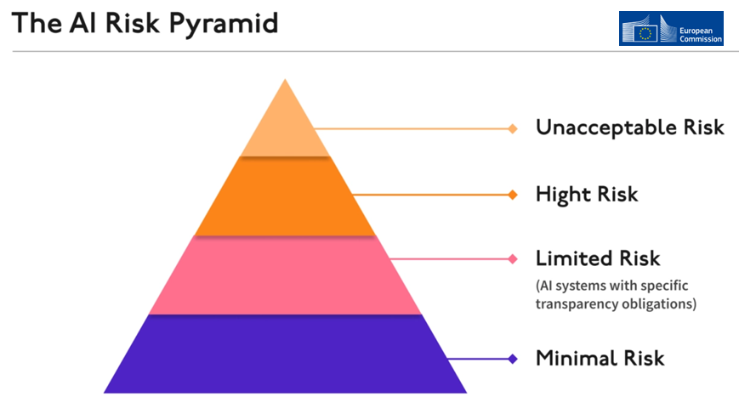
Legislation European union
EU GDPR - General Data Protection Regulation (2018)
Consumer Trust - Ensure businesses transparent about personal data use,
obtain explicit consent before collecting data.
EU AI Act Draft (14 June 2023)
Adoption target date: 2023 Dec. Date enforcement to begin: 2026
Notes:
GDPR entered into force on 24 May 2016 and applies since 25 May 2018 https://commission.europa.eu/law/law-topic/data-protection/data-protection-eu_en

Slide 18
Legislation AI Act - four risk levels
Unacceptable Risk:
Subliminal, manipulative, or exploitative systems that cause harm.
Real-time remote biometric ID systems: surveillance in public spaces.
Social scoring systems: social behavior or predicted personality traits.
Limited Risk:
AI chatbots for customer service interactions.
AI-powered inventory management systems.
AI systems for data analysis and predictive analytics in healthcare.
Users should be notified they are interacting with machine and provided ability to decline
High Risk:
Consumer creditworthiness evaluation.
Recruitment or employee management.
Biometric ID systems used for security purposes.
Minimal or No Risk:
Basic rule-based AI systems, limited functionality.
Video Games.
Educational purposes with no potential for harm
Notes:
AI Act Risk Examples
https://www.mckinsey.com/capabilities/quantumblack/our-insights/what-the-draft-european-union-ai-regulations-mean-for-business

Slide 19
AI Act amendments
General Purpose AI
General Purpose AI
For use with "wide range of applications" for which it is not specifically designed
Responsibilities - Foundation Models
Provider implement Risk Management, Data Governance, Security and ESG-by-Design, Enable downstream AI Providers to meet obligations, Quality Mgmnt for post-market monitoring, EU DB Registration
Responsibilities - Generative AI
Provider must inform natural persons of interaction with AI system, EU law breach safeguards, training data summary available
Foundational Model
Generative AI
Notes:
Baker Donelson
https://www.jdsupra.com/legalnews/chatgpt-in-the-crosshairs-how-the-eu-s-6938556/

Slide 20
Legislation united states
US State Legislation and Bills Proposed (multiple States)
US Federal AI Governance
National Artificial Intelligence Advisory Committee (NAIAC)
AI Bill of Rights (White House OSTP Executive Order)
Congress: Securities, Accountability, Foundations, Explain and Innovation Framework (SAFE) Bill
NIST AI Risk Management Framework (RMF)
Resource to help organizations design, develop, deploy, and use AI systems in trustworthy and responsible manner.
Addresses risks, impacts, and potential harms associated with AI technologies.

Slide 21
Open voice network conversational ai principles
Privacy
Conversational AI systems should deliver utility to users within publicly-stated parameters
Ensure user info not leveraged beyond intended purpose.
Inclusivity
Conversational AI systems should be designed to bring people in & be equipped to accommodate underrepresented & overrepresented populations.
Accountability
All stakeholders working to create conversational AI systems are accountable, & for system outcomes.
Sustainability
Conversational AI systems, whether in ongoing functionality or development, should not compromise economic, social, or environmental sustainability of our shared future.
Transparency
Users of conversational AI systems have right to understand how their data is used & how conversational AI system make decisions.
Compliance
Conversational AI systems should not merely align with abstract sense of morality & ethics but should comply in absolute terms with current laws & regulations.

Slide 22
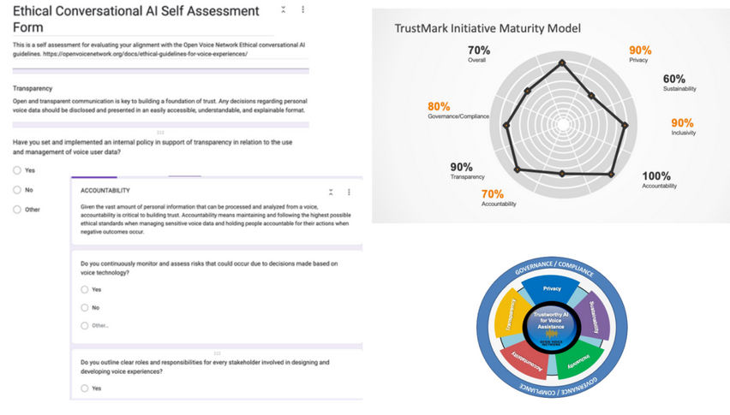
Open voice network conversational ai self assessment
Organizations evaluate how their own current structure and strategies align with TrustMark Initiative conversational AI guiding principles and core values.
Independent audit conducted on organization's framework. Upon completion and approval, organization will be added to TrustMark Initiative public list.
SAMPLE

Slide 23
Business Risks and Tactics summary
Experiment using chatbots in a measured approach - “AI Intern”.
Educate & Advocate CxO’s; integrate with Rhythm of Business processes.
AI has potential to be cybersecurity threat. And tool to mitigate threats.
NIST Framework, Roadmap, & Playbook resources a good start.
Open Voice Network Self-Assessment a great operational tool
Built for Conversational AI

Slide 24
Thank you
Michael Novak
Sr. Responsible AI Advisor, Open Voice Network
NIST Generative AI Work Group
LinkedIn: iotmichaelnovak

